Slide 1
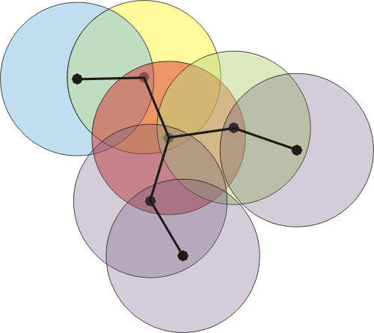
A Perspective on Routing in Wireless Mesh Networks
A. Bhorkar
University Qualifying Examination
University of California, San Diego
Notes:
In this presentation, I am going to talk about routing in wireless mesh networks. The talk is divided into two aspects of routing,
First considers controlling congestion while the other considers improving throughput when we do not access to the network topology
(35)

Slide 2
Motivation
Wireless Mesh Networks
Characteristics: Fixed, unlimited energy, virtually unlimited processing power
Dynamism – Link Quality
Optimize – Low latency, High throughput
Notes:
We envisage wireless mesh networks to develop soon also an a compliment for
Cellular entworks. These are typicallly fixed, unlimited enery. The dynamsn for ilnk quality. We need to optimize over high throughput, delay and balancing load. (35)

Slide 3
Research Objectives
To design a routing policy that exhibits good delay performance
1
Congestion Diversity Protocol (CDP)
Propose a metric that reacts to congestion
Experimental testbed in Calit2
Evaluate CDP
To design an opportunistic routing policy that enhances
throughput by minimizing the expected number of
transmissions
2
3
Notes:
The research objective of my work are as follows: First I would like to design
a routing policy that exhibits good delay performance. Here, I will describe the CDP protocol,
Where I will propose the metric which reacts to the congestion. Then, I will decrscibe the experimental testbed in Calit2. Finally, I will evaluate the CDP by comparing the performance
Compatitive protocols . In the next part I will briefly describe, I will describe the design of the opprtunistic routing policy that enhances the thoughput by minizing the expected number of transmissions.

Slide 4
Congestion Impact
Congestion
Increase
in traffic
Increase in network congestion
Increase in buffer packet drops
and delay
Need to provision for congestion in the network
Notes:
Congestion is detrimental to the network performance
With increase in demand for traffic the possibility that network gets congested is high. This may result in congestion collapse by increasing the number of packet drops and delay.
Hence we need to provision for congestion in the network.
(6 minutes)

Slide 5
Why New Routing Policy?
Time invariant policies
AODV
Hop count
GeRaF
Geographical distance
SRCR
ETX metric
S
Susceptible to congestion
Do not account for queue congestion
D
Notes:
There are many routing policies mainly they can be classified as time variant and time invariant
. The time invariant policies are congestion unaware while time variant policies are congestion aware. In time invariant policies, Aodv, Geraf, SRCR are time-invariant policies. AODV uses hop count as a distance measure, Geraf uses geogragrophcal distance, while
SRCR uses ETX as a metric which takes into account link probabilities rather than distance
into account
However, these routing policies are succeptable to congestion

Slide 6
Why New Routing Policy?
Time variant (congestion-aware)
Multipath Routing
(SMR-LB)
Create multiple (2) paths
Timeshare routes proportional to their average delay
Roots in minimum delay routing [Gallager84]
Slow to react
Backpressure routing
(BCP 10)
S
D
Selects forwarder with the smallest queue backlog
Spreads the traffic
Increases contention and delay
Need routing policy suitable for all traffic conditions
Notes:
There are time-varient policies which are congestion aware including
Multi-path routing and backpressure routing. In multi-path routing, SMR-LB creates
Two multiple paths and timeshare routes proportional to average delay.
The roots goes back to the minimum delay routing. These are slow to react.
There has been a recent implementation of backpressure routing in wireless sensor networks.
As we will see next, Backpressure routing selects It spreads the traffic, therby it increases the contention and delay..
It is proved to be throughput optimal.
It spreads the traffic, thery it increases the contention and delay..

Slide 7
Outline
CDP: A bird’s eye view
CDP components
CDP issues
Evaluation
Discussion and ongoing work
Notes:
First, I am going to talk about CDP with high level description
Then i will talk about the main components of CDP.
Then I will discuss CDP issues I faced while implementing the protocol.
I will then give performance results and finally discuss the ongoing work for CDP

Slide 8
Congestion Diversity Protocol : Bird’s eye view
CDP’s core is congestion aware routing
0.8
0.5
0.8
Routing decisions are based on congestion in the network
It exploits path diversity when available
S
D
0.9
0.8
Goal
Decentralized computation of the proposed congestion measure
Route efficiently to avoid congestion
Notes:
(8.5 minutes)
CDP protocol is based on the idea of congestion aware routing.
Routing decisions are based on congestion in the network
It exploits path diversity when available
The implemetaion goal is the decentralized computation of the proposed measure
and route the packets efficiently to avoid congestion.

Slide 9
Congestion Measure
Nodes are ordered according to a congestion measure V_{i} (t)
V_{i} (t) is the expected delay to reach the destination
V_{i} (t) < V_{j}(t) for all j i has lowest rank
Routing policy: select the forwarder with the lowest rank
2
0.8
0.5
0.8
If V₂(t) < V₁(t), node S will select 2 as the next forwarder
S
D
0.9
1
0.8
Notes:
We now introduce the congestion diversity protocol metric. In cdp, the nods are ordered according to a congestion measure Vi(t), where Vi(t) can be
Considered to be is the expected delay to reach the destination. If Vi < Vj then we say that j is lowest rank. We choose the forwarder with lowest rank. In this figure If V₂(t) < V₁(t), node S will select 2 as the next forwarder. Using the local information about
CDP, we can calculate Vi(t).
(10.5)

Slide 10
Characterization of congestion measure
V_{i} (t) are solutions to “Bellman-Ford” like equation
Local congestion
Expected delay from neighbor j
Queue length at node i
Link success probability between i and j
Effective draining time for node i
Notes:
The values of Vi(t) are calculated using a bellman like equation. In particular, it solves a fixed point equation, where Vj is expected congestion
Of neighbor j and Qi is the local congestion. Q_i/p-ij can be considered to be the draining time for node I
This congestion measure can be solved in a distributed manner
In bellman ford, this quantity is fixed, while it is time varying in our case
700 seconds

Slide 11
Congestion Granularity
CDP uses instantaneous queue lengths to detect congestion
CDP tracks the state of the network
Changes in congestion can be rapid
Due to channel fluctuations and traffic variations
Tackles the short term instantaneous congestion
Different from “minimum delay routing” [Gallager84]
Uses long term congestion for routing
Different from congestion control at transport layer
Transport layer caters to statistical, long term congestion
Notes:
I will now discuss the congestion regime CDP tried to address.
CDP uses instantaneous queue lengths to detect congestion,
i.e. CDP tracks the state of the network.
Note that changes in congestion in the network can be rapid due to ….
Hence, we need to tackle the short term instantaneous congestion.
It is different from “minimum delay routing” [Gallager84]
Which uses long term congestion for routing
It is different from congestion control at transport layer where transport layer caters to statistical, long term congestion

Slide 12
CDP Design
Determine V(t)
Control packets from neighbors
Compute V and broadcast control packet
Determine Link probability
200ms
Delayed feedback
Data Packets
Probe Packets
Mac Layer
Data Packet
Probe Packets
Phy layer
RX
TX
Notes:
CDP implementation in the stack.
Each node broadcasts a packet with the information for the effective delay in the congestion.
Generated in user space.
The nodes receive the packets with a delayed feedback. because the packets get lost due to channel.
Probe and data packets which are generated in the user space are used for
link probability calculations.

Slide 13
Link determination
Link quality updates (estimation of p_{ij}’s)
Active probing + passive probing
Broadcast-based active probing
Passive probing
Monitor received data packets
Detect missing data packets using sequence numbers
Estimate the link success probabilities
This reduces probing overhead
A
B
Capacity overhead - dedicated probe packets
Notes:
850
We will now look at link determinination , i.e. link probability estimation.
We use a combination of active probing and passive probing.
In active probing packets are broadcasted. E.g. in this example,
node A transmits packets while node B receives the corresponding packets. Depending on the number of received packets node A detemines the link probabiolity. In passive probing, the data packets are exploited to determine the link probabilty. We detect missing data packets using sequence numbers
And estimate the link success probabilities
This reduces probing overhead and offloads the active probing.

Slide 14
Scheduling
802.11 Mac
Node i selects one node j as a relay
Node j takes the responsibility of the packet
D
1
i
Control packets computing V are critical
Can get stuck due to congestion
Assign higher priority than data packets
Use driver’s priority queuing
j
j
N
Notes:
Now, we describe the scheduling in CDP. It uses 80211 mac. Node I selects the forwarder j and the
Forwarder takes the responsibility of forwarding the packets. The control packets in the calculation of V are critical as they can be stuck due to congestion. Hence, we assign heigher priority than data packets.

Slide 15
Design Issues (1)
Formation of loops
Curse of decentralized implementation
Temporary build-up of queue at F causes packets to loop in C-B
Counting to infinity situation
Split horizon rule is used to prevent routing loops
Node C knows B’s next hop is C
C sets V_{B} = ∞, C does not learn from B
A node advertises routes as unreachable to the node through which they were learned
D
F
C
A
B
Notes:
Next, I will determine the issues in the implementation of cdp. The first is formation of loops. It is
Due to the decentralized implementation of CDP. Consider a flow from node A to D.
Temporary build-up of queue at F causes C to believe that the delay though F is large. Hence
if F suddenly rises its queue length
(may be due to other flow), node C instead of routing to F it routes to node B.
This situation occurs everytime node F’s queue increases in burst and node B is not yet learnt about it.
It can be of order of ms. (about 200 packets.). We use of the shelf Split horizon rule is used to prevent routing loops
Node C knows B’s next hop is C
C sets V_{B} = ∞, C does not learn from B
A node advertises routes as unreachable to the node through which they were learned
(19 minutes)

Slide 16
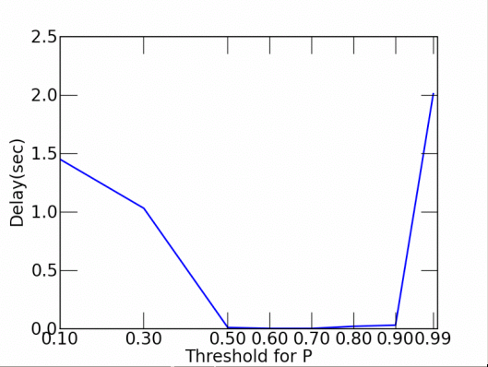
Design Issues (2)
Delay vs. link probability curve
Assumption:
Non linear, difficult to characterize
Packet are dropped after RETRY_MAX
Chosen a naïve solution
Neglect links with p < Threshold
Choose Threshold = 0.6
Media access
delay
?
0
1
Link probability
Notes:
1050
There is other issue of delay and link probability curve.
We had a assumption that the delay is inversely proportional to link probabilities.
However the curve is difficult to characterize. Furthermore , packets are dropped after retry_max, which we did not take into account. Here we choose a naaiv solution. We neglect the links with p< threshold. In this figure we plot the mean delay as the threshold is changed. For low threshold, the packets are routed along bad links, as their link qualities are overestimated.
In this work we choose a threshold of 0.6.
What is retry_max. ?

Slide 17
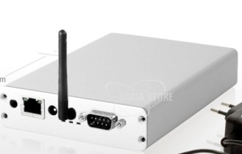
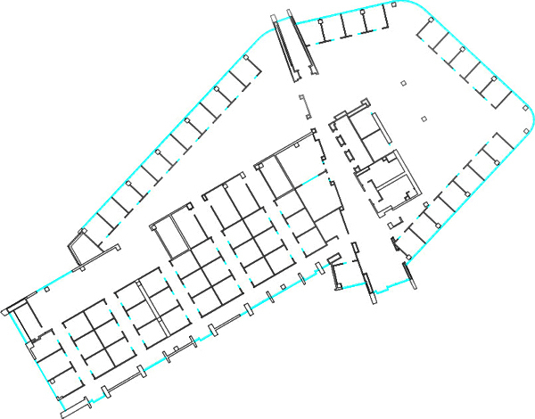
Experimental Setup
Indoor Network of 12 Alix nodes in Atkinson Hall (Calit2) 500Mhz CPU and 1GB flash.
MAC: Atheros IEEE 802.11 chipset (5212) using the MadWifi-NG driver.
Multiple hops (5 hops maximum)
13 dBm transmit power
4 neighbors average
~100 mt.
Comparative protocols:
SRCR
Back Pressure (BP)
Enhanced Back Pressure (E-BP)
Performance Measures
Mean end to end delay
Mean delivery ratio
Notes:
We now describe the experimental setup of CDP.
Indoor Network of 12 Alix nodes in Atkinson Hall (Calit2) 500Mhz CPU and 1GB flash.
MAC: Atheros IEEE 802.11 chipset (5212) using the MadWifi-NG driver.
Multiple hops (5 hops maximum)
13 dBm transmit power
4 neighbors average
The comparitive protocols used are Comparative protocols:
SRCR
Back Pressure (BP)
Enhanced Back Pressure (E-BP).
The performance metrics used are Mean end to end delay
Mean delivery ratio

Slide 18
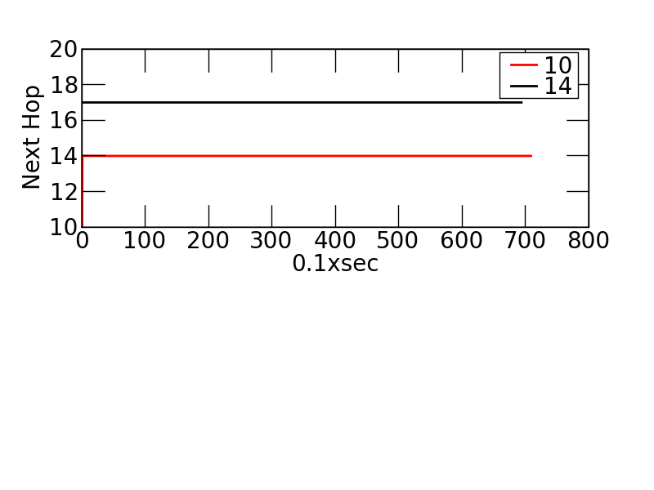
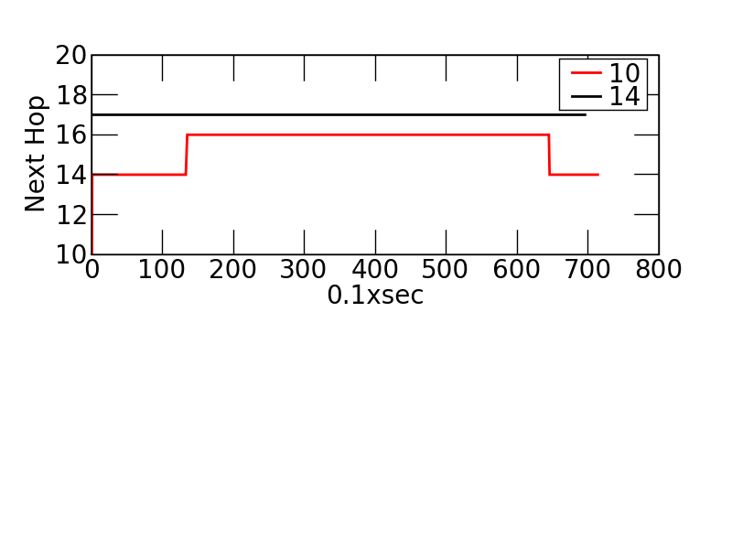
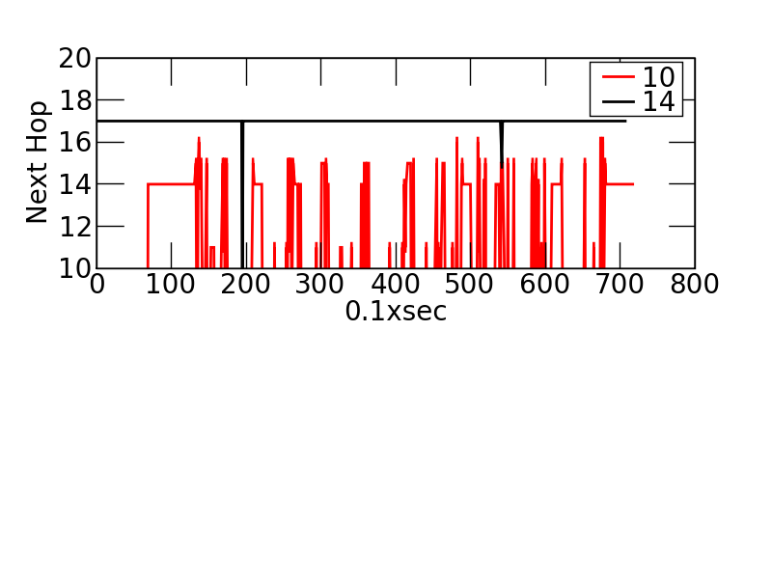
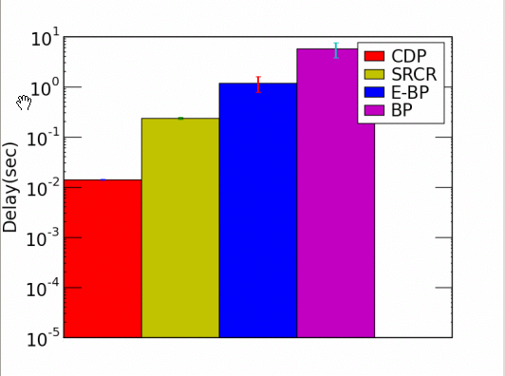
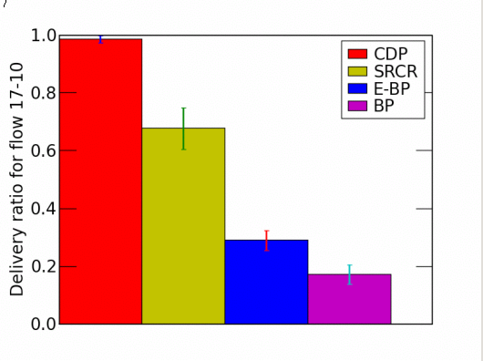
Canonical Example
SRCR
14
CDP
10
17
16
BP
50x
100x
Notes:
We now consider a canonical example, which shows a high gain for CDP. In this example the
Flow from node 10-17 is congested from the flow 14-16.
This plot plots the next hop for nodes 10, 14
SRCR being unaware of the congestion at node 10 routes the packets through node 16.
While CDP detects the congestion at node 16 and routes the packets through node 16.
Finally E-BP, spreads the packets and result in high delay. Next we plot the mean delay and
Delivary ratio for these protocols. CDP shows about 50x improvement w.r.t. delay and 100x w.r.t. BP.
Note that in this canonical example, short flow has heigher input rate, so that it can
Effectively congest the network

Slide 19
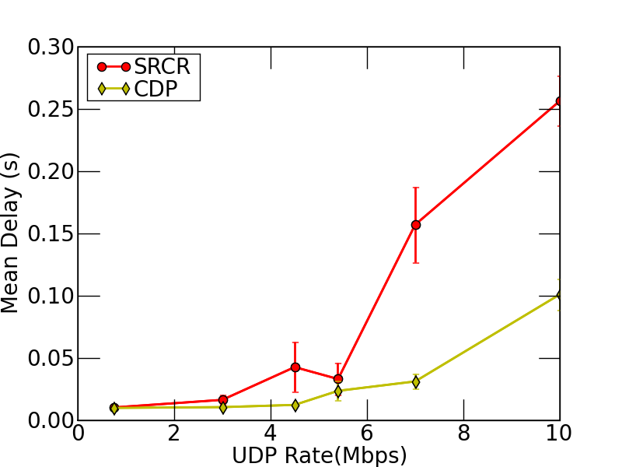
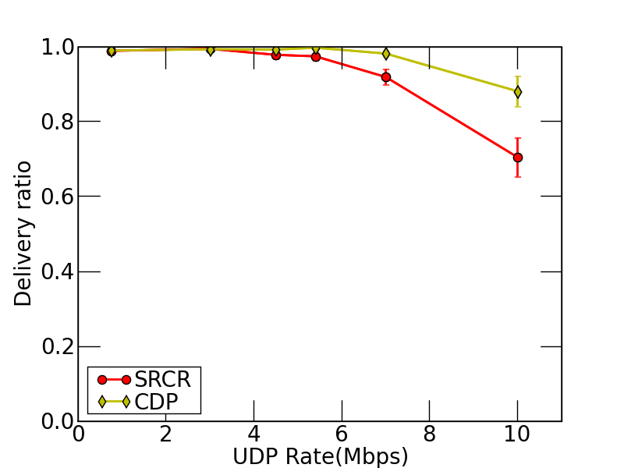
Examples(1)
14
10
17
16
Notes:
We have observed tha backpressure performs poorly, hence in some of the examples, I have only plotted against SRCR
In the next plots, we plot the performance result for the canonical example as the input rate is varied.. We have observed that as the UDP input rate is varied, there is a high gain for CDP w.r.t. delay and delivary ratio.
(26.30 minutes)

Slide 20
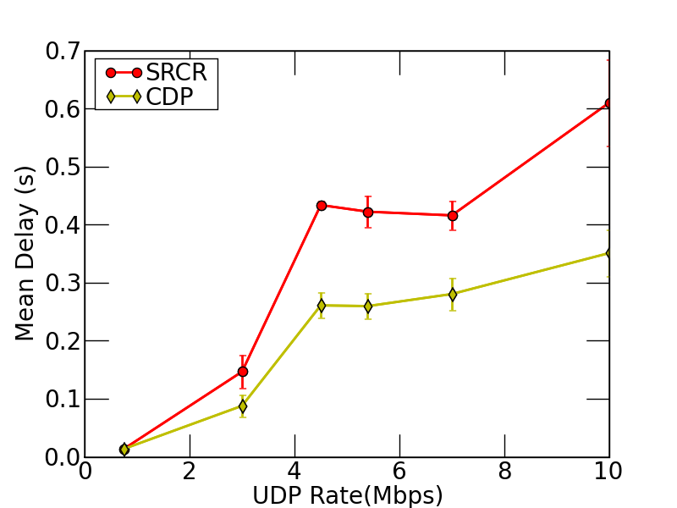
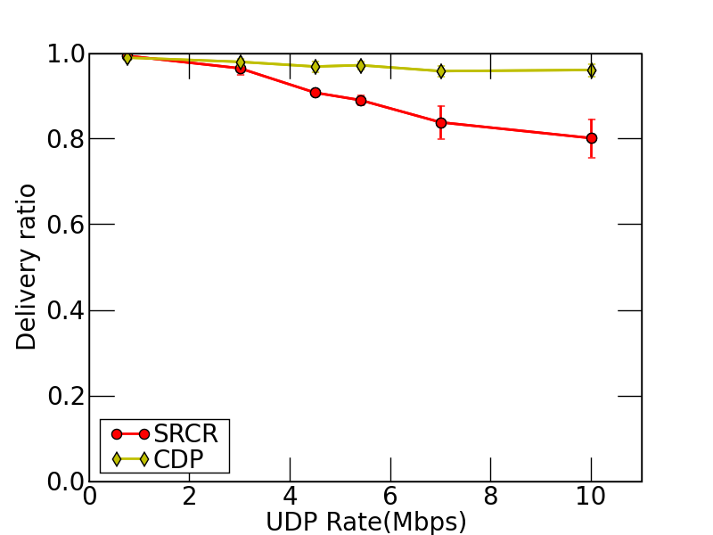
Examples(2)
4
14
10
17
8
Notes:
This second example, plots similar result, when the flow from node 4-8 is congested
due to other green flow.

Slide 21
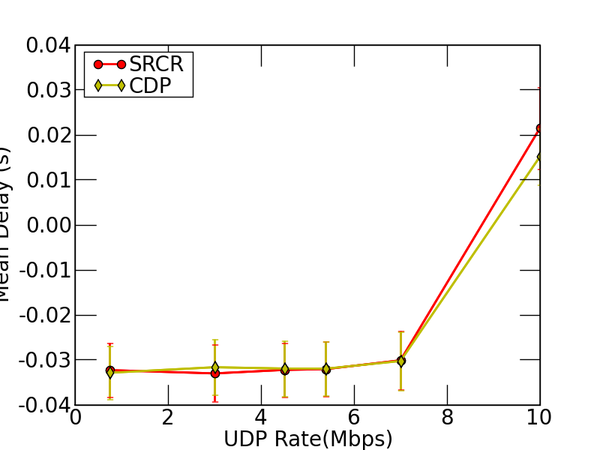
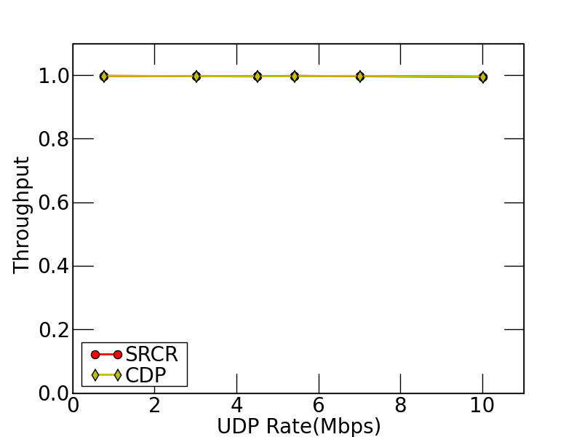
Examples(3)
Mean Delay
Single-hop flows: No gain
Delivery ratio
Notes:
When we have single flow, we do not have any gain over srcr.

Slide 22
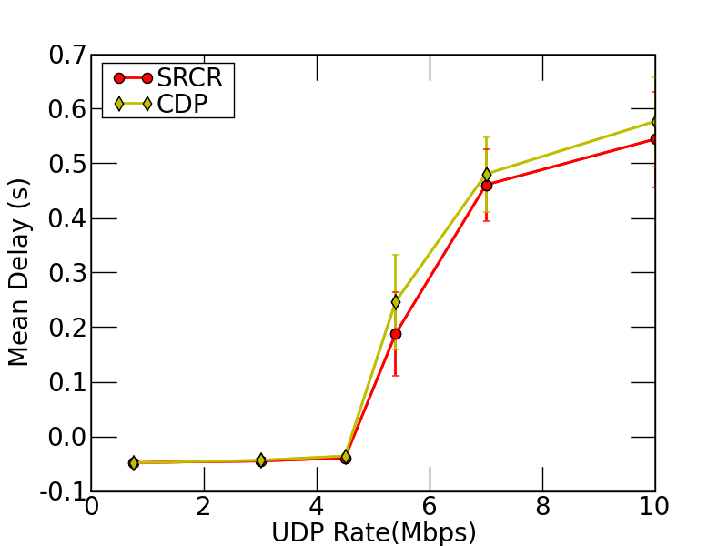
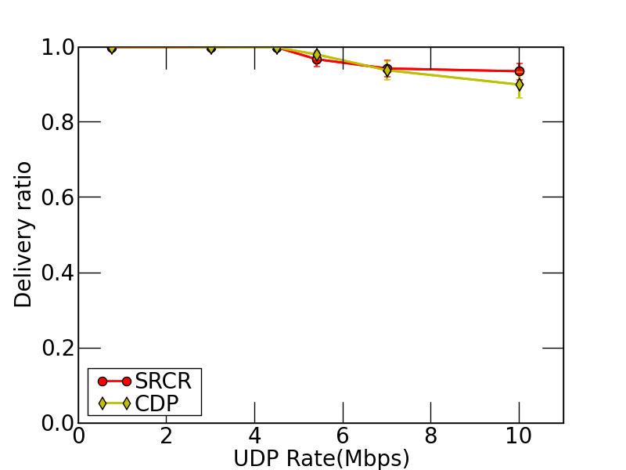
Nothing for free
11
17
¥
Inter-flow interference
Increase in potential number of transmitters
Notes:
However, the gain is not for free.
When we route the packets along multiple paths there is an increase in number of
Interferes. This decreases the gain in the CDP. Here we plot the effect of due to interflow interference. Here green flow interferes with the two routing paths for the orange flow.

Slide 23
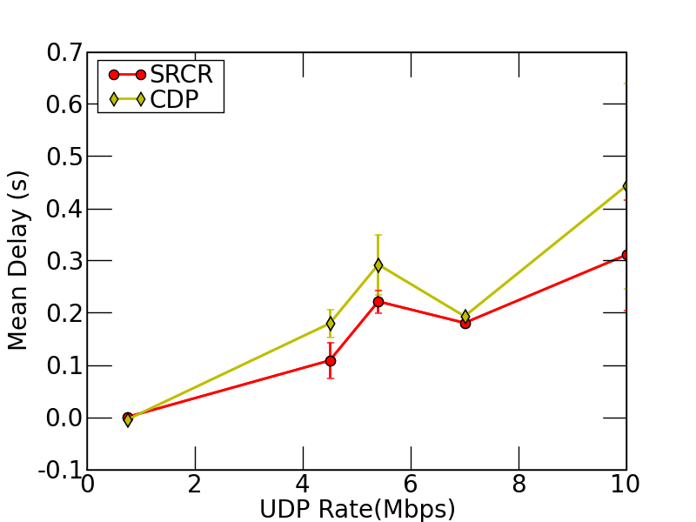
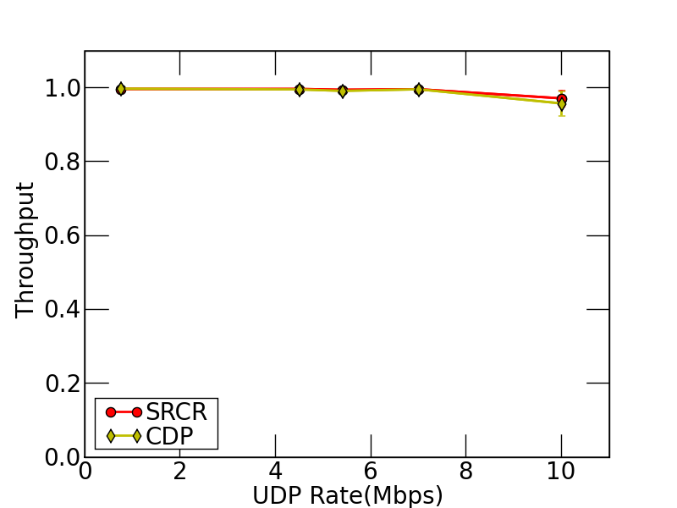
Nothing for free
11
13
7
¥
5
Intra-flow interference
(interference artificially increased by increasing power at interfering nodes)
Multiple paths create contention
Potential to degrade the performance
Notes:
1400
In this plot, we show the efffect of interference increase due to the same flow i.e. intraflow interference. Here the two routing paths 13-7 and 13-5-10-7 interfere with eachother.
To magnify the effect of interference, we have artificially increased the power at nodes 7,10.
Here, multiple paths degrade the performance as shown in figure.

Slide 24
Rule of Thumb
CDP shows improvement when
Network provides diversity
Many multi-hop routes are available
Many short length flows congest long length flow
Interflow and intraflow interference do not dominate the congestion
Notes:
As we have seen, we now state the rule of thumb for the performance
Improvement. CDP shows improvement when Network provides diversity
and there are many multi-hop routes are available
and many short length flows congest long length flow
And Interflow and intraflow interference do not dominate the congestion

Slide 25
Performance Results (Parameters)
UDP traffic
Random source destination pairs
Multiple concurrent flows (2 flows)
Choose UDP rates randomly
10 random topologies
80 sample points
Plot CDF of
mean delay of CDP - mean delay of candidate protocol
Ratio of delivery ratios
Notes:
Next we perform the experiments with UDP.
We choose Random source destination pairs with multiple concurrent flows (2 flows)
We choose UDP rates randomly
We consider 10 random topologies with 80 sample points
We plot CDF of
mean delay of CDP - mean delay of candidate protocol
Ratio of delivery ratios

Slide 26
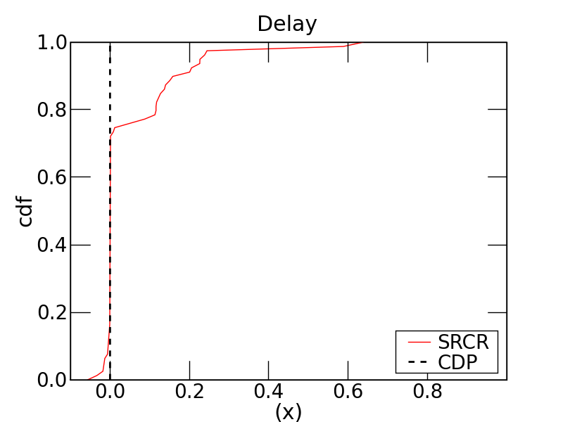
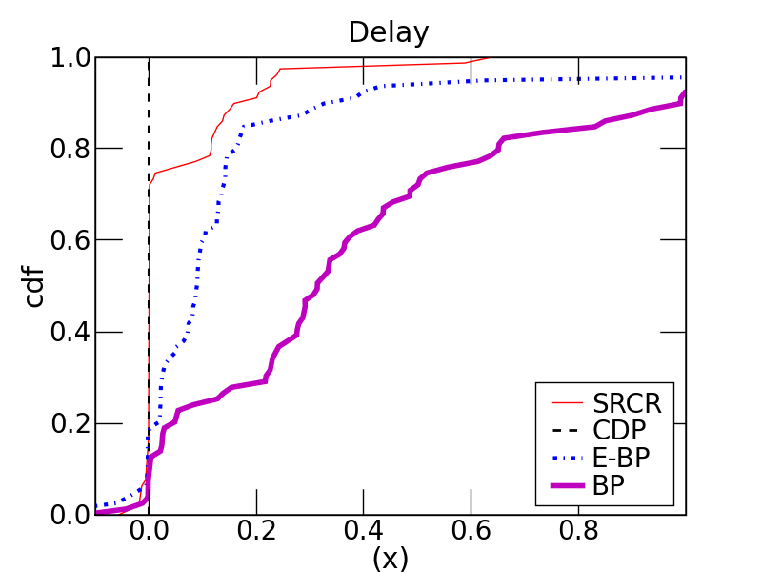
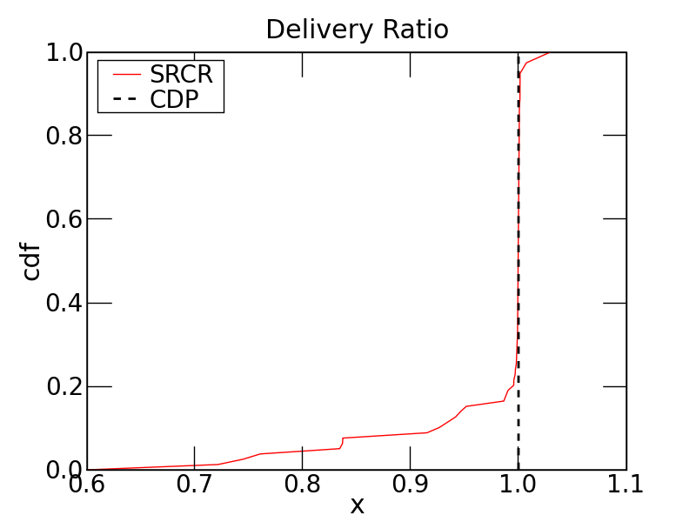
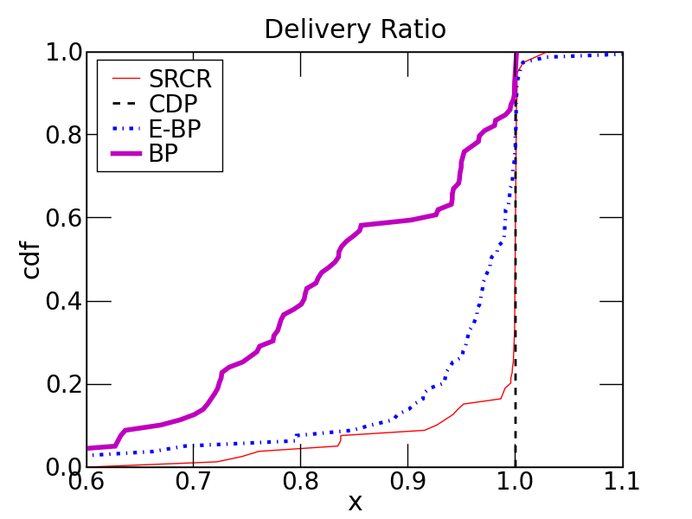
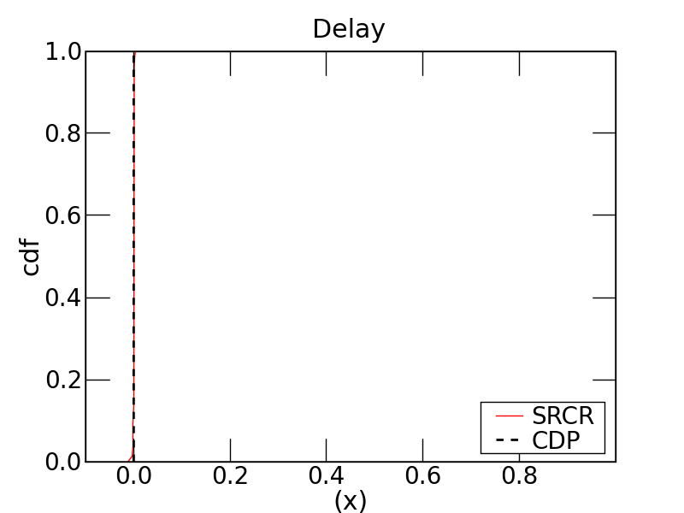
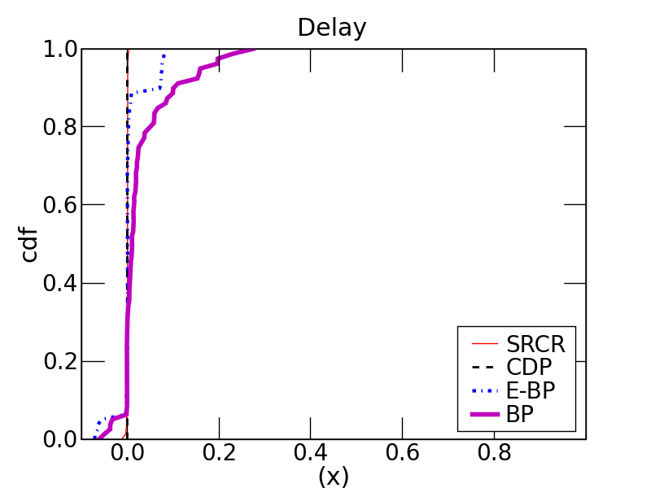
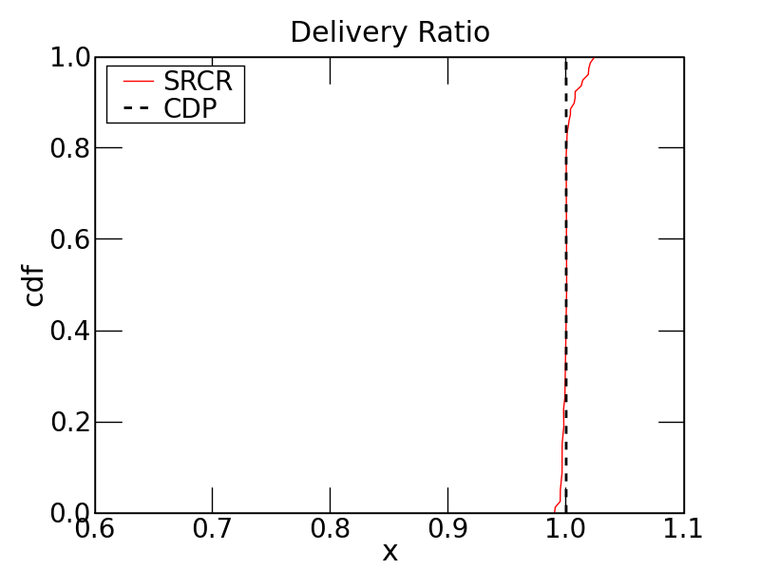
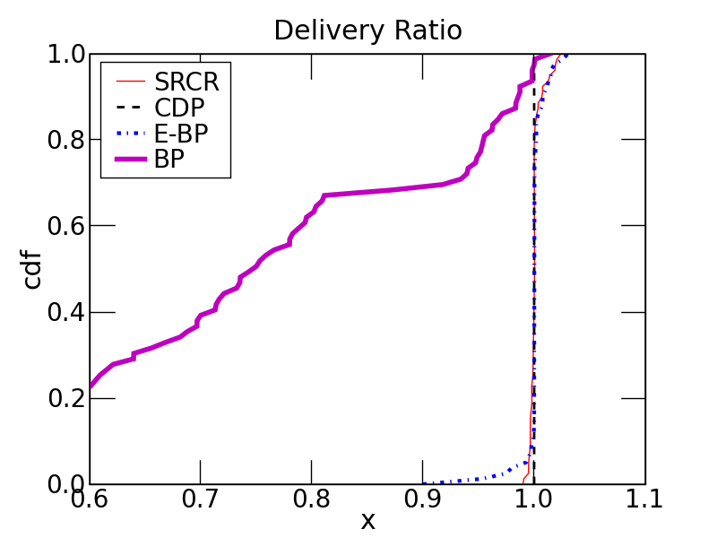
Performance Results
30%
High Load
Low Load
Notes:
1500
Next we plot the performance result when random source destination pairs are chosen. It has about 80 points. We can see that about 30%
Of the pair are getter and there is no loss.
One interestering point is backpressure performacne is poorer comapred
(34)

Slide 27
CDP: Summary
CDP exploits the congestion diversity in the network
CDP achieves high gain in the delay and delivery ratio for UDP traffic
CDP shows up to 50x gain over SRCR and 100x over backpressure routing
Routing Policy | Delay Performance
 | Low Traffic | High Traffic
Shortest-Path | Good delay performance | Poor delay
Backpressure | Poor delay performance | Guaranteed bounded delay Poor delay in practice
CDP | Good delay performance | Good delay in practice

Slide 28
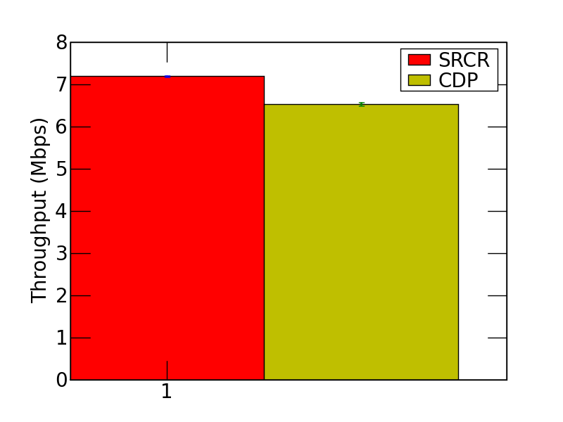
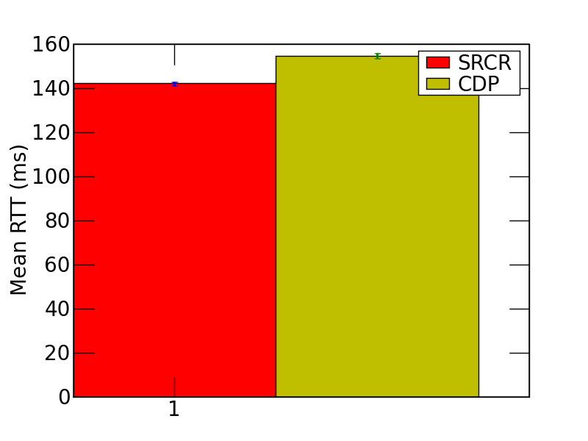
Current Focus (Interaction with TCP)
4
15
11
13
14
7
10
5
17
8
16
6
TCP performance hurts
Self interference
Reordering of packets
Fast retransmit
Which factor is more dominant?
Next hop for CDP
0.1xsec
Notes:
1500
TCP receives packets out of order.
TCP receiver accepts packets in sequences.
TCP acks demands for the packets that it was actually waiting.

Slide 29
Immediate Goals
Investigate the impact of CDP on TCP and mixed traffic
Detect the cause of performance loss for TCP
Tackle reordering issue in TCP
Include prioritized MAC in CDP
Change backoff proportional to the congestion
Notes:
1650
Next, I am going to discuss what are goals in near future..
We are currently investing the impact of TCP and mixed TCP/UDP traffic on CDP.
We have also started looking at multi-rate version, wherein, we utilize the multiple rates available at the MAC
Layer. We have some initial implementations for prio

Slide 30
Immediate Goals
Develop multi-rate CDP utilizing multiple PHY rates
Define congestion measure for multi-rate CDP
Implement opportunistic version of CDP on testbed
Modify MadWifi driver’s 802.11 Mac layer
S
D
1
0.8
2
0.8
0.8
S
D
0.2
3
0.8
Notes:
1650
We are currently investing the impact of TCP and mixed TCP/UDP traffic on CDP.
We have also started looking at multi-rate version, wherein, we utilize the multiple rates avaivailable at the MAC
Layer. We have some initial implementations for prio

Slide 31
Ongoing work
Objective | Timeline
CDP performance | Reordering of TCP (July) MIXED/TCP (August) | Summer Infocom, ToN
Prioritized MAC | October | Fall
Multi rate CDP | December | Fall
ORCD (Opportunistic CDP) | Mac layer modification (August) Analysis/Delay performance (Feb) | Spring 10 IMC/Mobicom
Notes:
40.5 minutes

Slide 32
Research Objectives
To design routing policy that exhibits good delay performance and study in a testbed.
1
To design an opportunistic routing policy that enhances
throughput by minimizing the expected number of
transmissions
2
Distributed Adaptive Opportunistic Routing (D-AdaptOR)
Opportunistic routing
Optimality
32
Notes:
The throughput improving policies require link probabilities to be known.
As said, we will first design opportunistic routing policy which
Minimizes expected number of transmissions
(40)

Slide 33
Adaptive Opportunistic Routing Protocol
?
With no link probability information, can we use only “DATA PACKETS” to efficiently route?
D
S
CDP : Explicit probe packets to determine topology
D-AdaptOR
Opportunistic setting (no congestion consideration)
Notes:
(30)
The idea of AdaptOR is to get the best of the two worlds.
There are opportunistic routing protocols, EXOR, SRCR, GERAF, which require topology information, while q-routing, ant-routing use dedicated probe packets to learn the topology. In this work, we pose the question, by removing the topology information can we efficeintly route the packets.

Slide 34
Opportunistic Routing
Routing decisions are made based on actual transmission outcomes via a three-way handshake.
 | Routing Cycle
1 | Transmission (T)
2 | Acknowledgment (A)
3 | Relaying (R)
1
0.8
2
0.8
0.8
S
D
0.2
3
0.8
Slot n
(T)
(A)
(R)
It exploits the broadcast nature of wireless transmissions.
Path diversity is available in many settings.
A long hop might be rare but it happens.
Notes:
(50) In opportunistic routing, the routing decisions are made based on actual transmissions outcomes via a three-way
Handshake.
First, in transmission stage the packet is transmitted.
In acknowledgement stage, the packet is acknowledged.
Finally in the relay stage the transmitter decides on the relay node.
The opportunistic routing exploits broadcast nature of wireless medium, by utilizing the path diversity available in many settings
And long hops which might me available in wireless medium.

Slide 35
Contribution
When topology known, there exists an algorithm with optimal performance
EXOR, GeRaF, SR
The knowledge of channel statistics is not known or erroneous
D-AdaptOR: Distributed Adaptive Opportunistic Routing protocol
D-AdaptOR has zero initial knowledge
Explores new opportunities
Decisions based on current information
Balances exploration with exploitation
Goal : Design an algorithm independent of channel knowledge while guaranteeing good performance
Notes:
70
When the topology is known, it known that there exisits a ginie algorithm whcich maximizes the expected reward However, in practice the knowledge of these link provbabilites is unkniown.
The relays closeness to the destination is incorrectly estimated. (800)
It can result in the performance degradation.
The goal of this talk is to design a universal algorithm which is oblivious to the underlying topology.
We present a D-adaptor algorithm which achieves the goal and maximizes the expected per packet reward.
We will interchangeably use the term network topology and link probabilistic interchangeably.

Slide 36
Network Model
D
1
Multi-hop ad-hoc network of nodes
Nodes connected by unreliable links
2
2
i
Transmission Model:
Node i broadcasts a packet
c_{i}: fixed cost of transmission
Set of nodes S successfully receive with probability P(S|i)
Error-free Ack packets
Slotted time:
Transmission and relay selection in one time slot
Only one node is selected as forwarder
S
N
Notes:
(60, 370)
We now describe the network model. We consider a ad-hoc network of nodes connected by unreliable links.
We now describe the transmission model for the network.
When node I transmits a packets we assume that cost ci is incurred.
Let S denote the set of nodes which successfully receive the packets.
We assume error free acks.
Furthermore, we assume slotted time, i.e. transmission and relay selection occur in one time slot.
We assume only one forwarder.

Slide 37
The Setup
:Sequence of relay nodes
:Time of termination
r :If packet is dropped before reaching destination then 0 reward, else reward R
1
D
2
R
o
Expected Reward
0
Termination Reward-Total Cost
A measure of distance
Notes:
80 sec
Consider a routing path for a packet.
Let io, i.n denote the sequence of relay node used for transmission of a packet.
Let te denote the time of termination, where the terminatoin event occurs
If the packet is dropped during relaying or it reaches the destination. Thus summation denote
Total cost for the packet till termination. We say that reward obtained is 0 if packet is dropped before the destination and reward obtained is R if I reaches the destination. We denote by a random variable the reward obtained. The total reward obtained is then given by termination reward-total cost. The expetation is taken the randomness of decision and channel variation process.
(80 sec)

Slide 38
Optimality Criterion
Problem (P) Maximize the expected average per packet reward when the link probabilities are not known
Based on received acks, the next decision is to
choose an ack-ed neighbor as the next relay,
retransmit,
drop the packet altogether
`
Reward for packet m
Notes:
We are now ready to formulate the problem. We would like to maximize the expected average
Per packet reward when the link probably P(S|i) is not known by choosing the sequence of relay nodes. Here, Mn is the number of packet terminated till time N..
The routing decision include choosing an acked Neighbor as the next relay, to retransmit or the drop the packet .

Slide 39
Main Result
Theorem:
The D-AdaptOR achieves optimality
maximizes
D-AdaptOR
When,
Channel statistics are ergodic
Control packets are reliable
D-AdaptOR maximizes the average per packet expected reward
Notes:
To provide performance bound on the algorithm, we would require some assumptions.
Link probabilities are ergodic
i.e. Only slow changes in topology are allowed
2) Acknowledgements are error free.
Then, d-adaptor maximizes the expected per packet reward

Slide 40
AdaptOR Operation
 | Routing Cycle
1 | Transmission (T)
2 | Ack (A)
3 | Relaying (R)
4 | Adaptive Update (U)
1
2
D
i
Receiving nodes acknowledge
Receiving nodes feedback their estimated reward
explores
exploits
Transmitter or when selecting the relay (randomized)
With high prob: Choose the node with best estimate
With diminishing prob: Choose randomly among neighbors
Adaptive
Update
Transmitter updates estimated reward
Notes:
In summary, we describe the algorithm. It has similar basic structure with the algorithm.
In the acknowledgement signal, the receiving nodes transmit a feedback, which contains the estimated reward.
In the selection process, the transmitter explores and exploits.
i.e. with high probability the relay with best estimate is chosen, while with diminishing probability we randomly choose
Among the receiving neighbors.
Finally, the transmitter updates with estimated reward.

Slide 41
AdaptOR: Summary
Developed distributed opportunistic routing algorithm D-AdaptOR
D-AdaptOR is optimal (under technical conditions)
D-AdaptOR outperformed other existing protocols in realistic simulations
D-AdaptOR achieved the exploration vs. exploitation tradeoff
D-AdaptOR can be implemented in off the shelf hardware
Relevant Papers
A. Bhorkar, M. Naghshvar, T. Javidi and B. Rao "An Adaptive Opportunistic Routing Scheme for Wireless Ad-hoc Networks ," submitted to IEEE Trans. on Networking.
A. Bhorkar, M. Naghshvar, T. Javidi and B. Rao ”AdaptOR An Adaptive Opportunistic Routing Scheme for Wireless Ad-hoc Networks “, ISIT 09
A. Bhorkar, M. Naghshvar, T. Javidi and B. Rao ”Exploration vs Exploitation in wireless Ad-hoc networks ,” CDC 09
Notes:
(23 minutes…) over..

Slide 42
Future work
Develop learning algorithms for time varying network dynamics
Optimize over exploration and increase convergence rate
Use “Regret” as a measure of optimality
Implement D-AdaptOR on test-bed
Objective | Timeline
No regret routing | Nearly complete | Asilomar 10
Relevant Papers
A. Bhorkar, T. Javidi, A. Snoeren, Achieving congestion diversity in wireless Ad-hoc networks, submitted to Mobicom 10
A. Bhorkar, T. Javidi, A. Snoeren, Achieving congestion diversity in wireless Ad-hoc networks, in preparation

