Slide 1



Non-Maximal Decimated
Filter Bank (NMDFB) and
Its Application in
Wideband Signal Processing
Dec 6, 2012
Xiaofei Chen

Slide 2
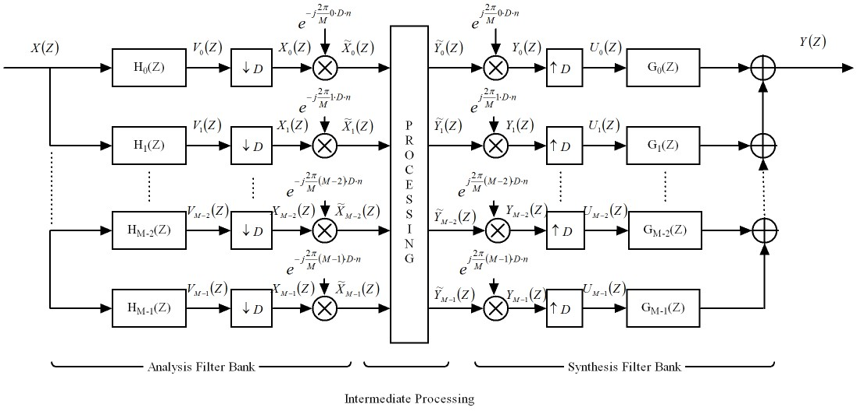
Non-Maximal Decimated Filter
Bank

Slide 3
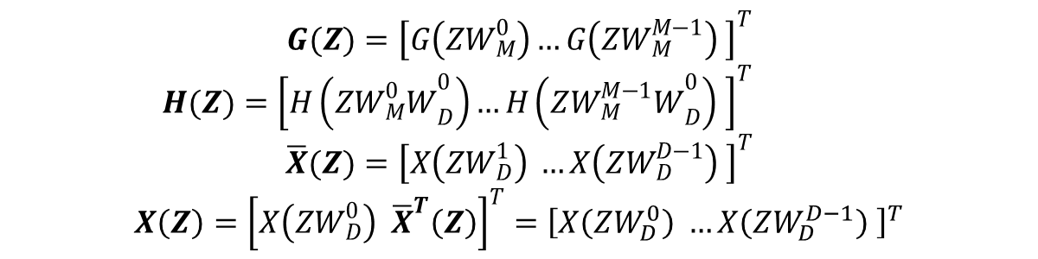
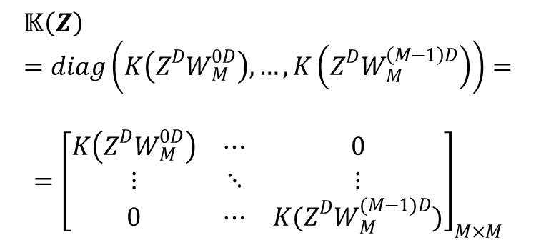
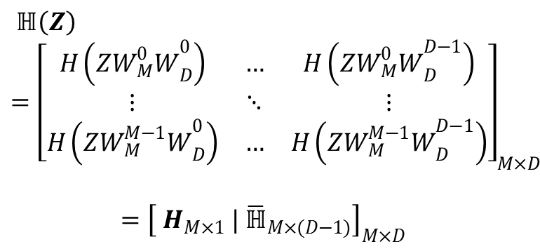
Non-Maximal Decimated Filter
Bank, Cont’d
$$G(Z)={\left[G\left(ZW_{M}^{0}\right)…G\left(ZW_{M}^{M−1}\right) \right]}^{T}$$
$H(Z)={\left[H\left(Z{W_{M}^{0}W}_{D}^{0}\right)…H\left(Z{W_{M}^{M−1}W}_{D}^{0}\right) \right]}^{T}$
$$\overline{X}(Z)={\left[X\left(ZW_{D}^{1}\right) …X\left(ZW_{D}^{D−1}\right) \right]}^{T}$$
$$X\left(Z\right)={\left[X\left(ZW_{D}^{0}\right) {\overline{X}}^{T}\left(Z\right)\right]}^{T}={\left[X\left(ZW_{D}^{0}\right) …X\left(ZW_{D}^{D−1}\right) \right]}^{T}$$
$$ℍ\left(Z\right)={\left[\begin{matrix}H\left(Z{W_{M}^{0}W}_{D}^{0}\right) & … & H\left(Z{W_{M}^{0}W}_{D}^{D−1}\right) \\ ⋮ & ⋱ & ⋮ \\ H\left(Z{W_{M}^{M−1}W}_{D}^{0}\right) & … & H\left(Z{W_{M}^{M−1}W}_{D}^{D−1}\right)\end{matrix}\right]}_{M×D}$$
$$={\left[ H_{M×1} | {\overline{ℍ}}_{M×(D−1)}\right]}_{M×D}$$
$$𝕂\left(Z\right)=diag\left(K\left(Z^{D}W_{M}^{0D}\right),…,K\left(Z^{D}W_{M}^{\left(M−1\right)D}\right)\right)=$$
$$={\left[\begin{matrix}K\left(Z^{D}W_{M}^{0D}\right) & ⋯ & 0 \\ ⋮ & ⋱ & ⋮ \\ 0 & ⋯ & K(Z^{D}W_{M}^{(M−1)D})\end{matrix}\right]}_{M×M}$$

Slide 4
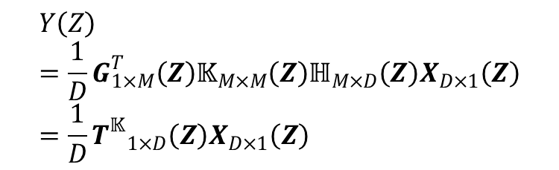
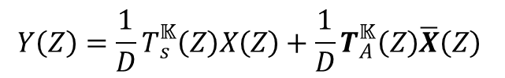
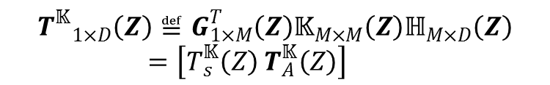
Non-Maximal Decimated Filter
Bank, Cont’d
$$Y\left(Z\right)=\frac{1}{D}G_{1×M}^{T}\left(Z\right)𝕂_{M×M}\left(Z\right)ℍ_{M×D}\left(Z\right)X_{D×1}\left(Z\right)=\frac{1}{D}{T^{𝕂}}_{1×D}\left(Z\right)X_{D×1}\left(Z\right)$$
$${T^{𝕂}}_{1×D}\left(Z\right)≝G_{1×M}^{T}\left(Z\right)𝕂_{M×M}\left(Z\right)ℍ_{M×D}\left(Z\right)=\left[T_{s}^{𝕂}\left(Z\right) T_{A}^{𝕂}\left(Z\right)\right]$$
$$Y\left(Z\right)=\frac{1}{D}T_{s}^{𝕂}\left(Z\right)X\left(Z\right)+\frac{1}{D}T_{A}^{𝕂}\left(Z\right)\overline{X}\left(Z\right)$$

Slide 5

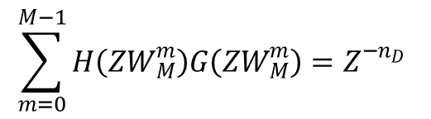
Non-Maximal Decimated Filter
Bank, Cont’d
Aliasing Cancellation Condition:
$$H\left(ZW_{D}^{d}\right)G\left(Z\right)=0,∀ d=1,…,D−1$$
Perfect Reconstruction Condition:
$$\sum_{m=0}^{M−1}{H\left(ZW_{M}^{m}\right)G\left(ZW_{M}^{m}\right)}=Z^{−n_{D}}$$

Slide 6
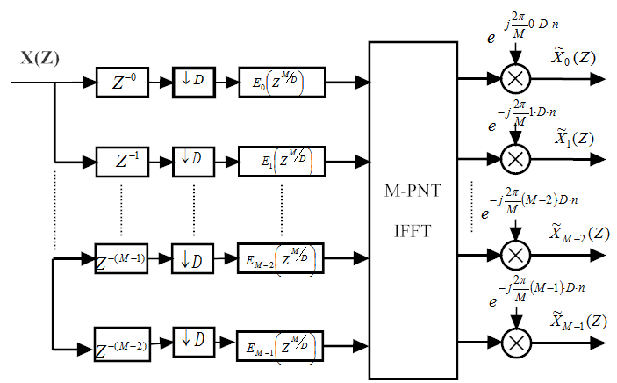
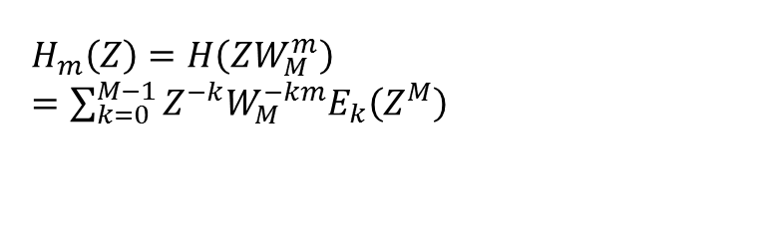
Polyphase Implementation of
NMDFB (AFB)
M-path Partition of the m^{th} channel filter:
$H_{m}\left(Z\right)=H\left(ZW_{M}^{m}\right)$ $=\sum_{k=0}^{M−1}{Z^{−k}W_{M}^{−km}E_{k}\left(Z^{M}\right)}$

Slide 7
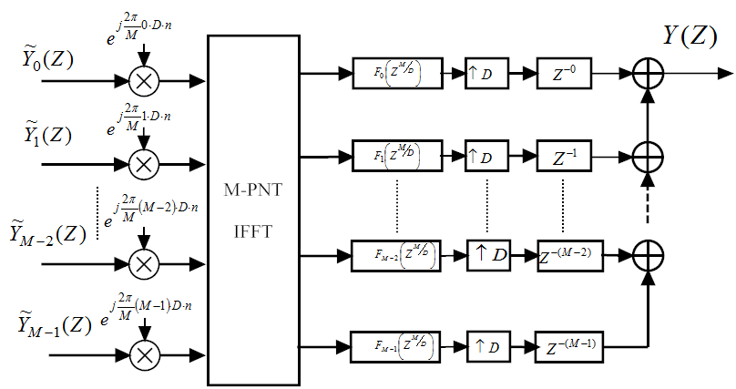
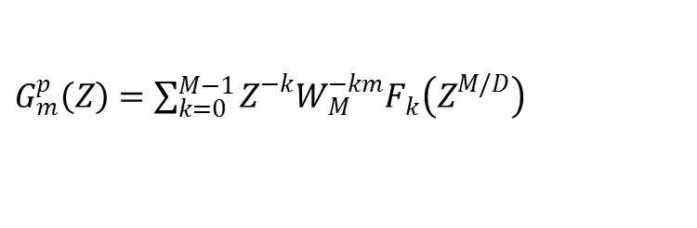
Polyphase Implementation of
NMDFB (SFB)
M-path Partition of the m^{th} channel synthesis filter:
$G_{m}^{p}\left(Z\right)=\sum_{k=0}^{M−1}{Z^{−k}W_{M}^{−km}F_{k}\left(Z^{M/D}\right)}$

Slide 8
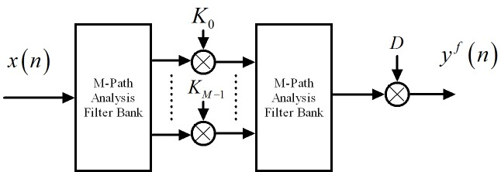
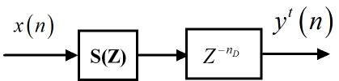

Filtering with NMDFB
NMDFB filter:
$$Y^{f}\left(Z\right)=T_{s}^{𝕂}\left(Z\right)X\left(Z\right)+T_{A}^{𝕂}\left(Z\right)\overline{X}\left(Z\right)≅T_{s}^{𝕂}\left(Z\right)X\left(Z\right)$$
Time Domain filter:
$$Y^{t}\left(Z\right)=S\left(Z\right)Z^{−n_{D}}X\left(Z\right)$$

Slide 9
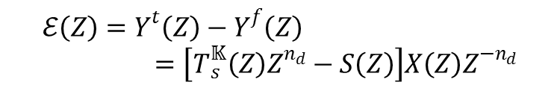
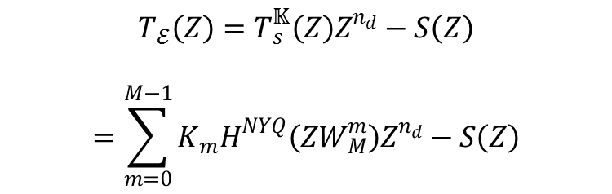
Filtering with NMDFB, Cont’d
Error between two filtering models:
$$ℰ\left(Z\right)=Y^{t}\left(Z\right)−Y^{f}\left(Z\right)=\left[T_{s}^{𝕂}\left(Z\right)Z^{n_{d}}−S\left(Z\right)\right]X\left(Z\right)Z^{−n_{d}}$$
Error Transfer Function:
$$T_{ℰ}\left(Z\right)=T_{s}^{𝕂}\left(Z\right)Z^{n_{d}}−S\left(Z\right)$$
$$=\sum_{m=0}^{M−1}{{K_{m}H}^{NYQ}\left({ZW}_{M}^{m}\right)Z^{n_{d}}}−S\left(Z\right)$$

Slide 10

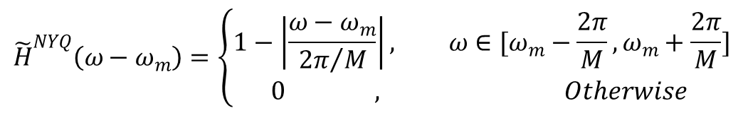

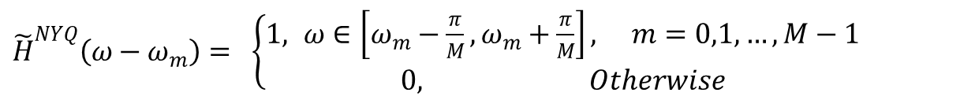
Filtering with NMDFB, Cont’d
Piecewise Constant Approximation:
${\tilde{h}}^{NYQ}\left(n\right)=\frac{1}{M}SINC\left(\frac{1}{M}n\right), for −n_{d}≤n≤n_{d}$
${\tilde{H}}^{NYQ}\left(ω−ω_{m}\right)=$ $\left\{\begin{aligned}1, ω∈\left[ω_{m}−\frac{π}{M},ω_{m}+\frac{π}{M}\right], m=0,1,…,M−1 \\ 0, Otherwise\end{aligned}\right.$
Linear Interpolation
$${\tilde{h}}^{NYQ}\left(n\right)=\frac{1}{M}{SINC}^{2}\left(\frac{1}{M}n\right), for −n_{d}≤n≤n_{d}$$
$${\tilde{H}}^{NYQ}\left(ω−ω_{m}\right)=\left\{\begin{aligned}1−\left|\frac{ω−ω_{m}}{{2π}/M}\right|, ω∈[ω_{m}−\frac{2π}{M},ω_{m}+\frac{2π}{M}] \\ 0 , Otherwise \end{aligned}\right.$$

Slide 11
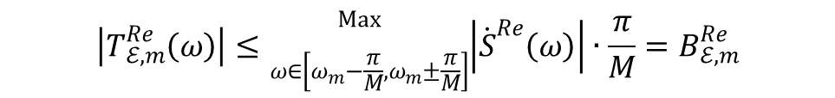

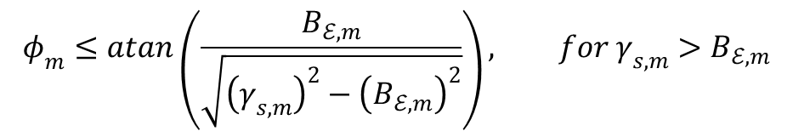
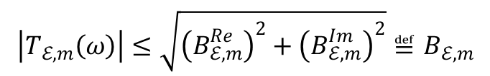
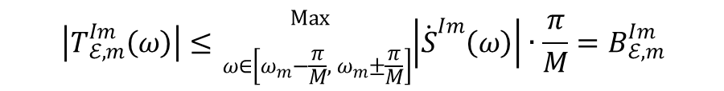
Filtering with NMDFB, Cont’d
Piecewise Constant Approximation Performance:
$$\left|T_{ℰ,m}^{Re}\left(ω\right)\right|≤{}_{ω∈\left[ω_{m}−\frac{π}{M},ω_{m}±\frac{π}{M}\right]}^{\operatorname{Max}{ }}{\left|{\dot{S}}^{Re}\left(ω\right)\right|}∙\frac{π}{M}=B_{ℰ,m}^{Re}$$
$$\left|T_{ℰ,m}^{Im}\left(ω\right)\right|≤{}_{ω∈\left[ω_{m}−\frac{π}{M},{ ω}_{m}±\frac{π}{M}\right]}^{\operatorname{Max}{ }}{\left|{\dot{S}}^{Im}\left(ω\right)\right|}∙\frac{π}{M}=B_{ℰ,m}^{Im}$$
$$\left|T_{ℰ,m}\left(ω\right)\right|≤\sqrt{{\left(B_{ℰ,m}^{Re}\right)}^{2}+{\left(B_{ℰ,m}^{Im}\right)}^{2}}≝B_{ℰ,m}$$
$$φ_{m}≤atan\left(\frac{B_{ℰ,m}}{\sqrt{{\left(γ_{s,m}\right)}^{2}−{\left(B_{ℰ,m}\right)}^{2}}}\right), for γ_{s,m}>B_{ℰ,m}$$
$$γ_{s,m}≝{}_{ω∈\left[ω_{m}−\frac{π}{M} ,ω_{m}±\frac{π}{M}\right]}^{Min }{ \left|S\left(ω\right)\right|}$$

Slide 12
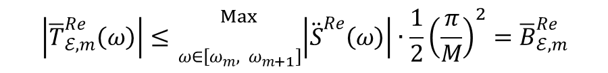

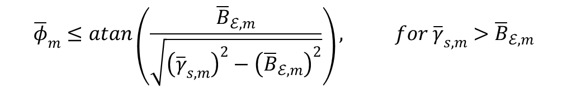
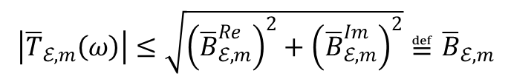
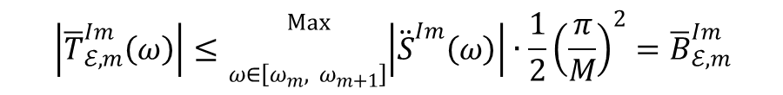
Filtering with NMDFB, Cont’d
Linear Interpolation Approximation Performance:
$$\left|{\overline{T}}_{ℰ,m}^{Re}\left(ω\right)\right|≤{}_{ω∈\left[ω_{m},{ ω}_{m+1}\right]}^{\operatorname{Max}{ }}{\left|{\ddot{S}}^{Re}\left(ω\right)\right|}∙\frac{1}{2}{\left(\frac{π}{M}\right)}^{2}={\overline{B}}_{ℰ,m}^{Re}$$
$$\left|{\overline{T}}_{ℰ,m}^{Im}\left(ω\right)\right|≤{}_{ω∈\left[ω_{m},{ ω}_{m+1}\right]}^{\operatorname{Max}{ }}{\left|{\ddot{S}}^{Im}\left(ω\right)\right|}∙\frac{1}{2}{\left(\frac{π}{M}\right)}^{2}={\overline{B}}_{ℰ,m}^{Im}$$
$$\left|{\overline{T}}_{ℰ,m}\left(ω\right)\right|≤\sqrt{{\left({\overline{B}}_{ℰ,m}^{Re}\right)}^{2}+{\left({\overline{B}}_{ℰ,m}^{Im}\right)}^{2}}≝{\overline{B}}_{ℰ,m}$$
$${\overline{φ}}_{m}≤atan\left(\frac{{\overline{B}}_{ℰ,m}}{\sqrt{{\left({\overline{γ}}_{s,m}\right)}^{2}−{\left({\overline{B}}_{ℰ,m}\right)}^{2}}}\right), for {\overline{γ}}_{s,m}>{\overline{B}}_{ℰ,m}$$
$${\overline{γ}}_{s,m}≝{}_{ω∈\left[ω_{m} ,ω_{m+1}\right]}^{Min }{ \left|S\left(ω\right)\right|}$$

Slide 13
NMDFB Design Example
M = 64, D = 32
Rectangular
M = 64, D = 32
Triangular
M = 64, D = 16
Triangular

Slide 14
NMDFB Simulation
M = 64, D = 32 Rectangular
Impulse Response and Filter Spectra

Slide 15
NMDFB Simulation, Cont’d
M = 64, D = 16 Triangular
Impulse Response and Filter Spectra

Slide 16
NMDFB Simulation, Cont’d
M = 64, D = 16 Triangular
Impulse Response and Filter Spectra

Slide 17
NMDFB Filtering Simulation 1
M = 64, D = 32 Rectangular / M = 256 Triangular
Linear Phase Filtering

Slide 18
NMDFB Filtering Simulation 2
M = 64, D = 32 Rectangular / Triangular
Non Linear Phase Filtering

Slide 19
NMDFB Filtering Simulation 2
M = 256, D = 64 Triangular
Non Linear Phase Filtering

Slide 20
NMDFB Filtering: Fractional Delay
M = 64, D = 16 Triangular
Fractional Delay Filtering

Slide 21
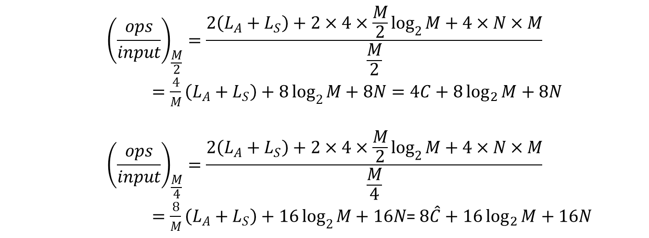
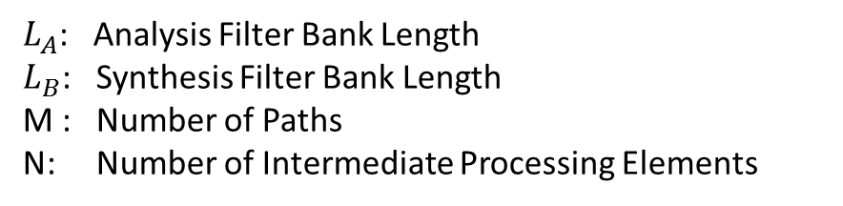
NMDFB Filtering Workload
$L_{A}$: Analysis Filter Bank Length
$L_{B}$: Synthesis Filter Bank Length
M : Number of Paths
N: Number of Intermediate Processing Elements
$${\left(\frac{ops}{input}\right)}_{\frac{M}{2}}=\frac{2\left(L_{A}+L_{S}\right)+2×4×\frac{M}{2}\log_{2}{M}+4×N×M}{\frac{M}{2}}$$
$=\frac{4}{M}\left(L_{A}+L_{S}\right)+8\log_{2}{M}+8N=4C+8\log_{2}{M}+8N$
$${\left(\frac{ops}{input}\right)}_{\frac{M}{4}}=\frac{2\left(L_{A}+L_{S}\right)+2×4×\frac{M}{2}\log_{2}{M}+4×N×M}{\frac{M}{4}}$$
$=\frac{8}{M}\left(L_{A}+L_{S}\right)+16\log_{2}{M}+16N$= $8\hat{C}+16\log_{2}{M}+16N$

Slide 22
NMDFB APPLICATIONS
Wideband Signal Processing: Effectively reducing the hardware processing rate via NMDFB.
Filtering: Linear phase, Non-linear phase, Fractional delay, Masking, Cascade Filtering.
Support block timing varying filtering.
Support wideband power allocation.

Slide 23
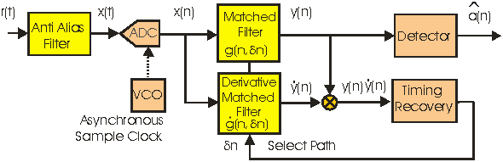
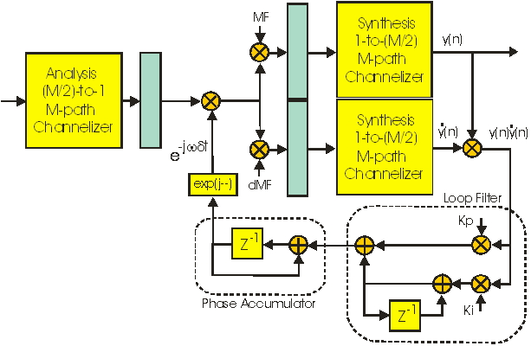
Communication Example
256 Real Multiplies per Output
Time Domain Timing Recovery & Matched Filtering
240 Real Multiplies per Output
NMDFB Domain Timing Recovery & Matched Filtering

Slide 24
Communication Example
NMDFB Timing Recovery Simulation (Submitted to ICASSP 2013)
20 dB SNR / AWGN channel / 0.25 Ts Timing Error

Slide 25
Thanks!
Open for questions Now!

