Slide 1
Three-user Interference Channel with a Cognitive Transmitter: An Information Theoretic Perspective
Oct. 11, 2012
Myung Gil Kang
Wireless Communication Systems Laboratory (WCSL)
Korea Advanced Institute of Science and Technology (KAIST)
Notes:
Good afternoon. Let me start my presentation. My name is Myung Gil Kang from KAIST Korea.
In this presentation, I will propose the Capacity of a Three-user Interference Channel with a Cognitive Transmitter in Strong Interference.

Slide 2
Contents
Introduction
System Model
Capacity Region of the Strong Interference Channel
Interference Alignment with Rate Splitting
Conclusions
Notes:
This is agenda of my presentation.
Firstly, I’ll introduce some related works. And I’ll explain about system model and the channel classification.
Then, the capacity region of the strong interference channel will be explained.
And the capacity region and channel conditions will be shown for Gaussian case.
Finally, I’ll conclude the presentation.

Slide 3
1st
Introduction
Related works
2 user interference channels
[Han and Kobayashi, 1981]
[Costa and Gamal, 1987]
[Etkin et al., 2008]
[Annapureddy and Veeravalli, 2009]
Notes:
interference management is one of the most important issues in wireless communications system .
The conventional interference management schemes were orthogonalization of wireless resources such as freq/time/codes
This can be explained as cake cutting approach and each user obtains 1/K wireless resource in K –user IC.
For several years, interference alignment is proposed as new interference managing scheme.
The main concept of IA is to make the interfering signals aligned at each receiver.
In K-user IC, K/2 DoF is shown to be achieved.
And in K-user M×M interference channel KM/2 DoF is proved to be achieved.
All users can achieve the half of wireless resources.

Slide 4
1st
Introduction
Related works
K-user interference channels ($K>2$)
[Sridharan et al., 2008]
[Cadambe and Jafar, 2008]
Notes:
interference management is one of the most important issues in wireless communications system .
The conventional interference management schemes were orthogonalization of wireless resources such as freq/time/codes
This can be explained as cake cutting approach and each user obtains 1/K wireless resource in K –user IC.
For several years, interference alignment is proposed as new interference managing scheme.
The main concept of IA is to make the interfering signals aligned at each receiver.
In K-user IC, K/2 DoF is shown to be achieved.
And in K-user M×M interference channel KM/2 DoF is proved to be achieved.
All users can achieve the half of wireless resources.

Slide 5
1st
Introduction
Related works
2 user cognitive interference channels
[Devroye et al., 2006]
[Wu et al., 2007]
[Maric et al., 2007]
[Maric et al., 2008]
Notes:
interference management is one of the most important issues in wireless communications system .
The conventional interference management schemes were orthogonalization of wireless resources such as freq/time/codes
This can be explained as cake cutting approach and each user obtains 1/K wireless resource in K –user IC.
For several years, interference alignment is proposed as new interference managing scheme.
The main concept of IA is to make the interfering signals aligned at each receiver.
In K-user IC, K/2 DoF is shown to be achieved.
And in K-user M×M interference channel KM/2 DoF is proved to be achieved.
All users can achieve the half of wireless resources.

Slide 6
1st
Introduction
Related works
2 user interference channels with a cognitive relay
[Sahin and Erkip, 2007]
[Sahin et al., 2009]
[Rini et al., 2011]
Notes:
interference management is one of the most important issues in wireless communications system .
The conventional interference management schemes were orthogonalization of wireless resources such as freq/time/codes
This can be explained as cake cutting approach and each user obtains 1/K wireless resource in K –user IC.
For several years, interference alignment is proposed as new interference managing scheme.
The main concept of IA is to make the interfering signals aligned at each receiver.
In K-user IC, K/2 DoF is shown to be achieved.
And in K-user M×M interference channel KM/2 DoF is proved to be achieved.
All users can achieve the half of wireless resources.

Slide 7
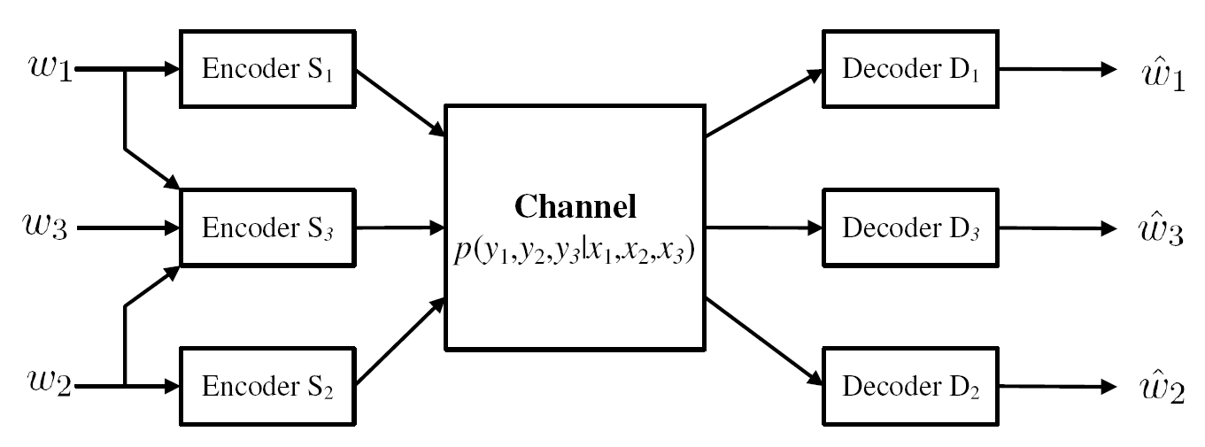
2nd
System Model
Configuration
S₃: cognitive transmitter
S_{k}: non-cognitive transmitter
Memoryless and discrete channel given by
If
where denotes the capacity region of the 3-user IC with a cognitive Tx.

Slide 8
3rd
Capacity Region of the Strong Interference Channel
Related works
Capacity achievable schemes
 | Weak interference | Moderate interference | Strong interference
2 user IC | Treating interference as noise | Rate splitting (within one bit) | Jointly decoding
K-user IC | Unknown |  | Lattice coding (very strong)
2 user cognitive IC | Gel’fand-Pinsker coding | Unknown | Superposition coding with jointly decoding
2 user IC with a cognitive relay | Unknown |  | Superposition coding with jointly decoding
3 user IC with a cognitive transmitter | Unknown
Notes:
interference management is one of the most important issues in wireless communications system .
The conventional interference management schemes were orthogonalization of wireless resources such as freq/time/codes
This can be explained as cake cutting approach and each user obtains 1/K wireless resource in K –user IC.
For several years, interference alignment is proposed as new interference managing scheme.
The main concept of IA is to make the interfering signals aligned at each receiver.
In K-user IC, K/2 DoF is shown to be achieved.
And in K-user M×M interference channel KM/2 DoF is proved to be achieved.
All users can achieve the half of wireless resources.

Slide 9
3rd
Capacity Region of the Strong Interference Channel
Related works
Capacity achievable schemes
 | Weak interference | Moderate interference | Strong interference
2 user IC | Treating interference as noise | Rate splitting (within one bit) | Jointly decoding
K-user IC | Unknown |  | Lattice coding (very strong)
2 user cognitive IC | Gel’fand-Pinsker coding | Unknown | Superposition coding with jointly decoding
2 user IC with a cognitive relay | Unknown |  | Superposition coding with jointly decoding
3 user IC with a cognitive transmitter | Unknown |  | Our work
Notes:
interference management is one of the most important issues in wireless communications system .
The conventional interference management schemes were orthogonalization of wireless resources such as freq/time/codes
This can be explained as cake cutting approach and each user obtains 1/K wireless resource in K –user IC.
For several years, interference alignment is proposed as new interference managing scheme.
The main concept of IA is to make the interfering signals aligned at each receiver.
In K-user IC, K/2 DoF is shown to be achieved.
And in K-user M×M interference channel KM/2 DoF is proved to be achieved.
All users can achieve the half of wireless resources.

Slide 10
3rd
Capacity Region of the Strong Interference Channel
Sketch of the proof (Capacity region)
Inner Bound
Four channel conditions
Capacity region
with 8 channel conditions
=
Four channel conditions
Outer bound
Notes:
Thus, we consider 3-dimensional complex sphere S0.
And S0 can be divided into two parts according to some direction c and the some thickness lambda.
And each part can be defined like this.

Slide 11
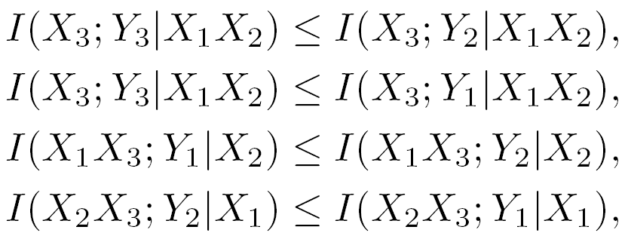
3rd
Capacity Region of the Strong Interference Channel
Outer bound
Theorem 3-1. For the interference channel conditions
for all input distributions , the capacity region of a three-user interference channel with a cognitive transmitter has an outer bound
S₃ → D_{k}: strong
S_{k} → D_{l}: strong
Notes:
Thus, we consider 3-dimensional complex sphere S0.
And S0 can be divided into two parts according to some direction c and the some thickness lambda.
And each part can be defined like this.

Slide 12
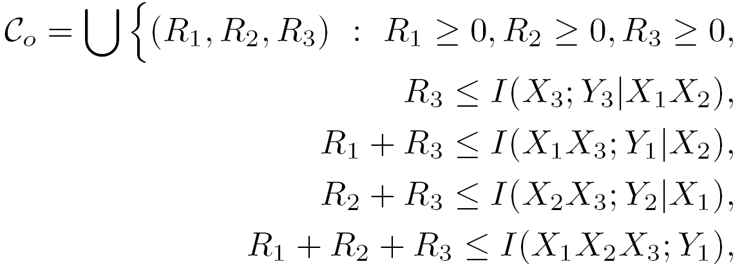
3rd
Capacity Region of the Strong Interference Channel
Outer bound
for all input distributions .
Notes:
Thus, we consider 3-dimensional complex sphere S0.
And S0 can be divided into two parts according to some direction c and the some thickness lambda.
And each part can be defined like this.

Slide 13
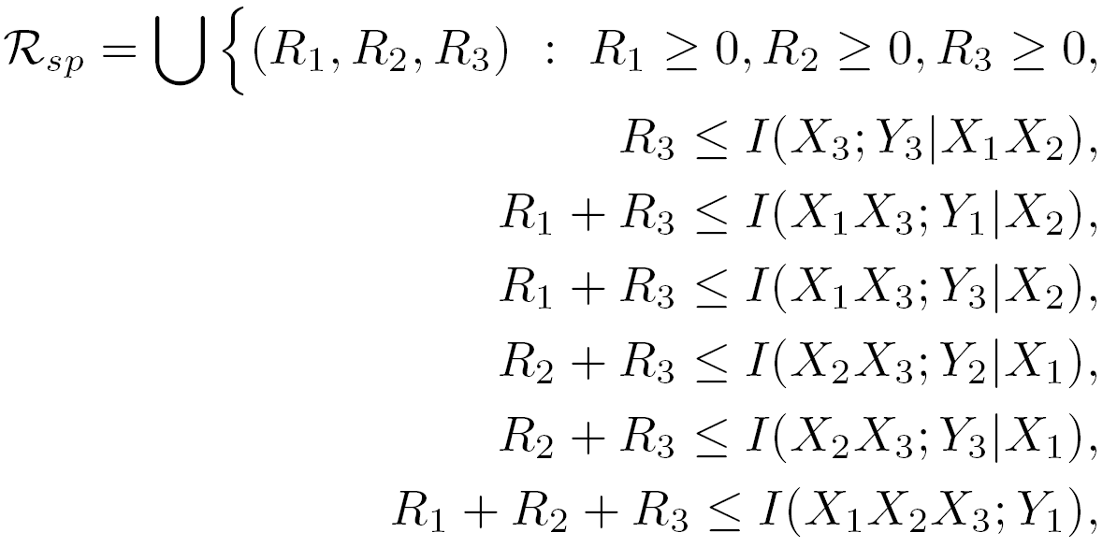
3rd
Capacity Region of the Strong Interference Channel
Inner bound
Theorem 3-2. If the cognitive transmitter adopts superposition coding and all decoders jointly decode all the messages, the achievable rate region is the set of all achievable rate triples such that
for all input distribution .
S_{k} → D₃: strong
Notes:
Thus, we consider 3-dimensional complex sphere S0.
And S0 can be divided into two parts according to some direction c and the some thickness lambda.
And each part can be defined like this.

Slide 14
3rd
Capacity Region of the Strong Interference Channel
Capacity region
Theorem 3-3. For the interference channel condition which satisfies
for all input distributions ,
S₃ → D_{k}: strong
S_{k} → D_{l}: strong
S_{k} → D₃: strong
Notes:
Thus, we consider 3-dimensional complex sphere S0.
And S0 can be divided into two parts according to some direction c and the some thickness lambda.
And each part can be defined like this.

Slide 15
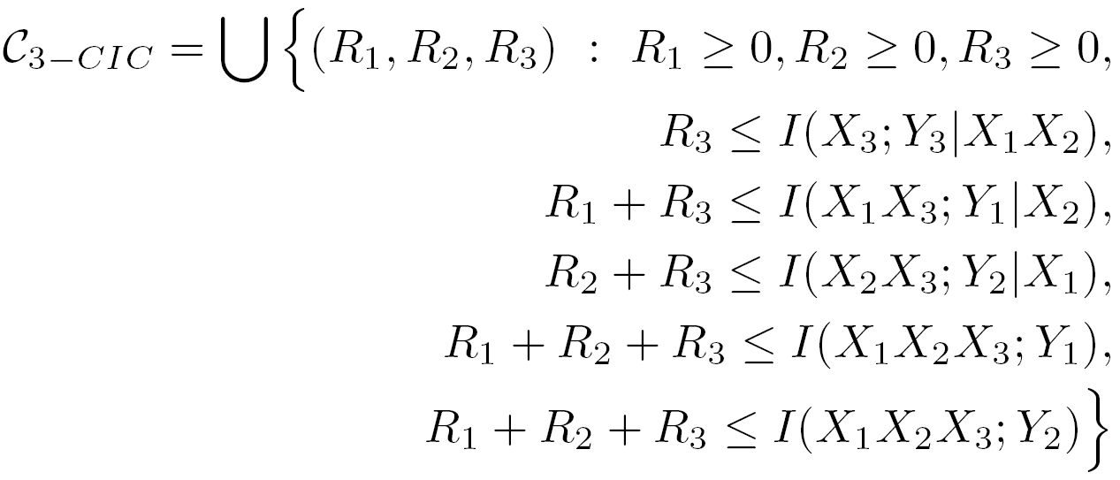
3rd
Capacity Region of the Strong Interference Channel
Capacity region
the capacity region of the three-user interference channel with a cognitive transmitter is determined by
for all input distributions .
Notes:
Thus, we consider 3-dimensional complex sphere S0.
And S0 can be divided into two parts according to some direction c and the some thickness lambda.
And each part can be defined like this.

Slide 16
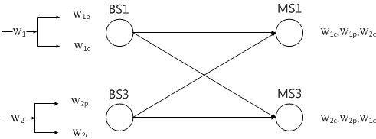
4th
Interference Alignment with Rate Splitting
Rate splitting
Split the message into two types
Private message – Optimal in weak interference regime
Common message – Optimal in strong interference regime
Notes:
Thus, we consider 3-dimensional complex sphere S0.
And S0 can be divided into two parts according to some direction c and the some thickness lambda.
And each part can be defined like this.

Slide 17
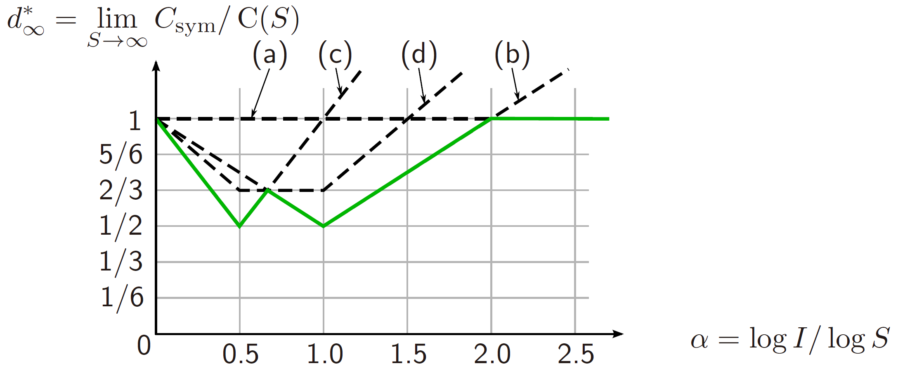
4th
Interference Alignment with Rate Splitting
Rate splitting
Generalized DoF
Weak
Strong
Notes:
Thus, we consider 3-dimensional complex sphere S0.
And S0 can be divided into two parts according to some direction c and the some thickness lambda.
And each part can be defined like this.

Slide 18
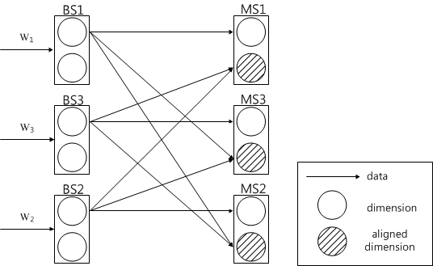
4th
Interference Alignment with Rate Splitting
Interference alignment
Half dimension for desired signal
The other dimension for interference alignment
1/2 DoF achievable for each user
Notes:
Thus, we consider 3-dimensional complex sphere S0.
And S0 can be divided into two parts according to some direction c and the some thickness lambda.
And each part can be defined like this.

Slide 19
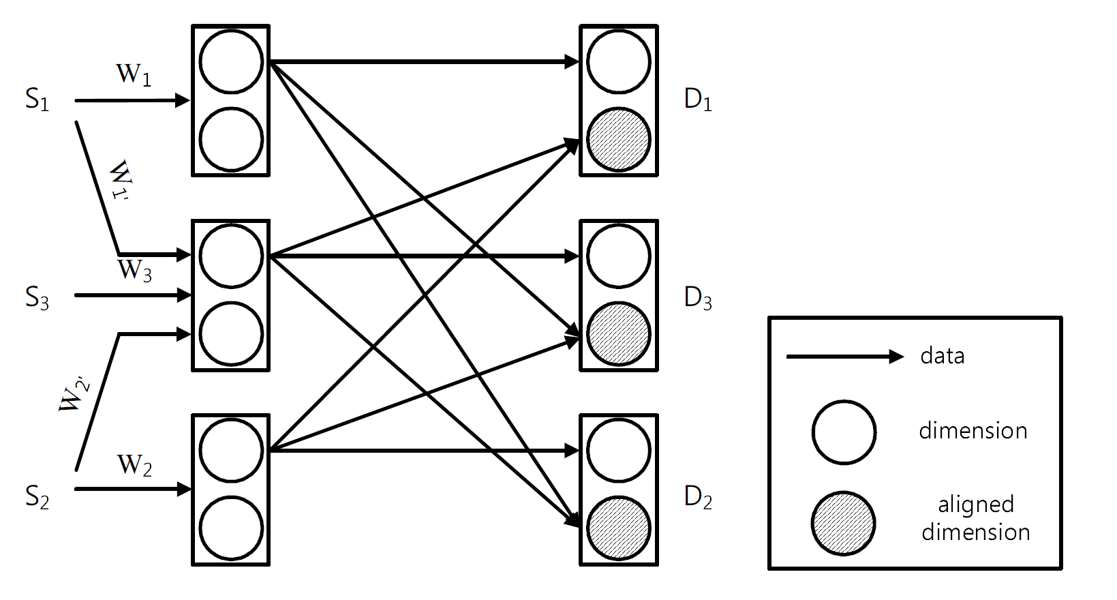
4th
Interference Alignment with Rate Splitting
Interference alignment with rate splitting
Key idea
Dimension recycling
Interference aligned effective channel
Notes:
Thus, we consider 3-dimensional complex sphere S0.
And S0 can be divided into two parts according to some direction c and the some thickness lambda.
And each part can be defined like this.

Slide 20
4th
Interference Alignment with Rate Splitting
Encoding rule
Notes:
Thus, we consider 3-dimensional complex sphere S0.
And S0 can be divided into two parts according to some direction c and the some thickness lambda.
And each part can be defined like this.

Slide 21
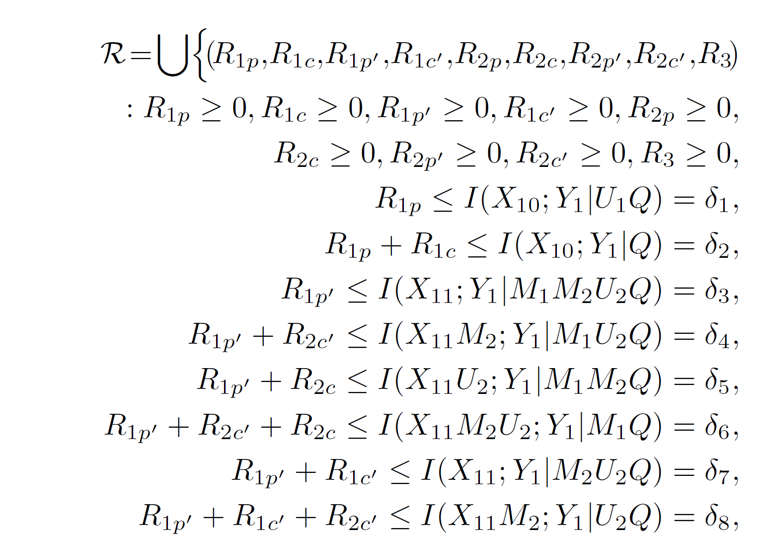
4th
Interference Alignment with Rate Splitting
Achievable rate region
Theorem 4-1. The achievable rate region is determined by the convex hull of all non-negative rate triple (R₁, R₂, R₃) such that
Notes:
Thus, we consider 3-dimensional complex sphere S0.
And S0 can be divided into two parts according to some direction c and the some thickness lambda.
And each part can be defined like this.

Slide 22
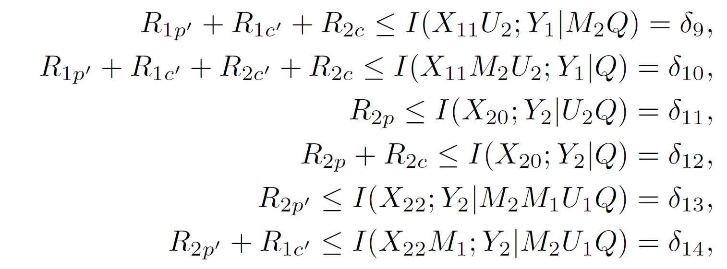
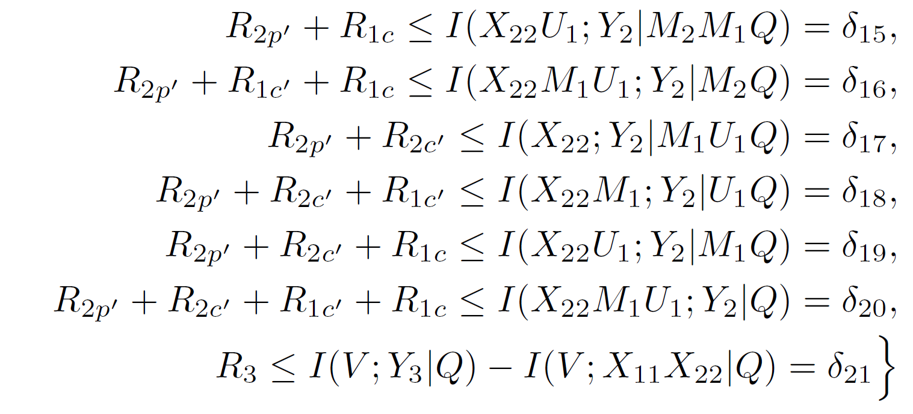
4th
Interference Alignment with Rate Splitting
Notes:
Thus, we consider 3-dimensional complex sphere S0.
And S0 can be divided into two parts according to some direction c and the some thickness lambda.
And each part can be defined like this.

Slide 23
4th
Interference Alignment with Rate Splitting
for all input distribution
Notes:
Thus, we consider 3-dimensional complex sphere S0.
And S0 can be divided into two parts according to some direction c and the some thickness lambda.
And each part can be defined like this.

Slide 24
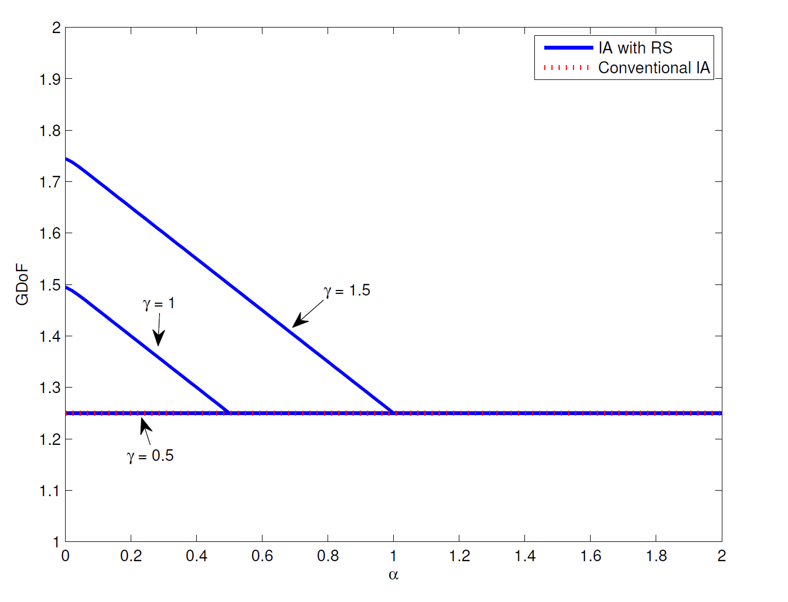
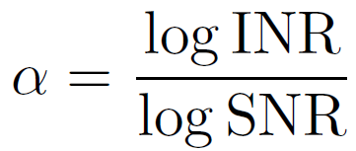
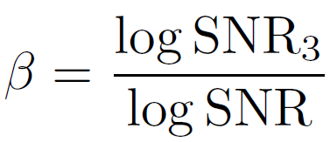
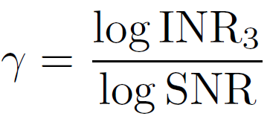
4th
Interference Alignment with Rate Splitting
Generalized DoF
β = 0.5
Notes:
Thus, we consider 3-dimensional complex sphere S0.
And S0 can be divided into two parts according to some direction c and the some thickness lambda.
And each part can be defined like this.

Slide 25
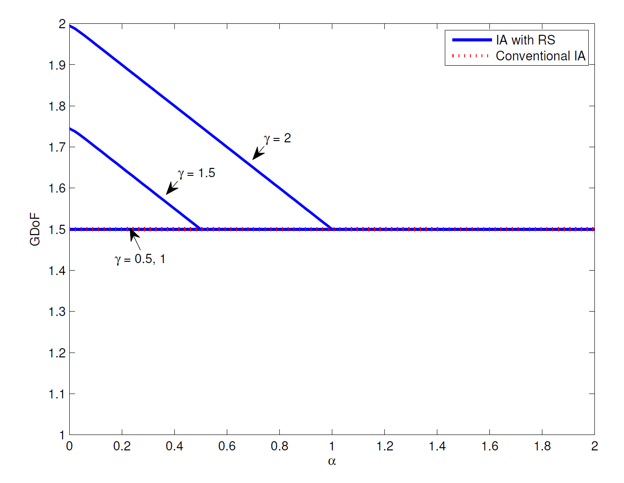
4th
Interference Alignment with Rate Splitting
Generalized DoF
β = 1
Notes:
Thus, we consider 3-dimensional complex sphere S0.
And S0 can be divided into two parts according to some direction c and the some thickness lambda.
And each part can be defined like this.

Slide 26
5th
Conclusions
Capacity region when all cross-channels are strong.
Newly derived outer bounds are achieved by superposition coding and joint decoding.
Interference alignment with rate splitting
Proposed scheme recycles the sacrificed dimension.
GDoF becomes larger as γ increases.

Slide 27
Thank you for your attention

