Slide 1
2012 Group meeting in UCSD
[ ]
Compressed Sensing and
Its Application on Communication System
Nov. 1st, 2012
Jun-pyo Hong
Wireless Communication System Laboratory
Department of Electrical Engineering, Korea Advanced Institute of Science and Technology

Slide 2
Contents | Stuffs discussed in this presentation
Contents
1st
Introduction to Compressed Sensing
2nd
Sparsity Controlled Random Multiple Access with Compressed Sensing
3rd
Support Set Recovery with Unknown Sparsity Level

Slide 3
1st
Introduction to
Compressed Sensing

Slide 4
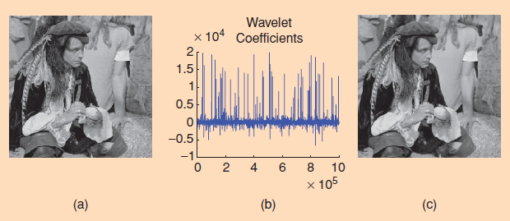
1-1
Compression Exploiting Signal Sparsity
Characteristic of natural signals
Sparse or compressible representation in a certain basis
Transform coding
Sampling & Transforming → Taking only a few significant coefficients e.g. JPEG, MPEG, MP3, …

Slide 5
1-2
What is Compressed Sensing?
Compressed sensing (CS)
Directly sense data in a compressed form y
Large reduction in sampling and computation costs for sensing signal
Recovery
Given A and Ψ, recover x from y (underdetermined problem)
Practical recovery algorithm (e.g. l₁ based linear optimization)
m×k measurement matrix
k×k transform matrix
m×1 measurement vector
k×1 signal
Sparse representation of x

Slide 6
1-3
Applications
Well known applications
Extremely expensive measurements (e.g. Imaging via neutron scattering )
Slow sensing process (e.g. MRI)
Difficulties applying CS to communication systems
Most CS literature has focused extensively on
Signal approximation.
Providing error bounds in the worst case.
Information theoretic approaches of CS [Jin, Kim, and Rao, 2011], [Wainwright1, 2009], [Wainwright2, 2009]
Based on detection and average performance metric
Providing hints for applying CS to communication

Slide 7
1-4
Compressed Sensing
Useful characteristic of CS
Non-adaptive sensing : (A is independent of x)
→ Do not require information about x except how sparse it is
→ follow the same sensing procedure no matter what x is
Good properties for distributed systems

Slide 8
2nd
Sparsity Controlled Random Multiple Access with Compressed Sensing

Slide 9
2-1
Introduction
Random multiple access
Each user transmits a packet without full coordination among users.
Advantages over coordinated multiple access in
Networks consisting of large numbers of users
Networks with ad-hoc characteristics
Random multiple access in a collision channel model [Bianchi, 2000]
Collision → Discard packets (e.g. ALOHA, CSMA,…)
As # of users grows, user latency rapidly increases.
Random multiple access in PHY channel model
Multiuser detection with active user identification [Wu and Chen, 1998], [Lin and Lim, 2004]
Required resources for identifying users m ≥ Total # of users k
This assumption would be wasteful if # of active users s is much smaller than k.

Slide 10
2-2
Motivation
Active user identification with compressed sensing
Active user sparsity # of active users s << total # of users k
Similar to support set recovery problem in compressed sensing [Jin, Kim, and Rao, 2011][Wainwright1, 2009], [Wainwright2, 2009]
In this work,
Utilize compressed sensing technique for efficient user identification
Propose distributed scheduling methods for improving system throughput
Asymptotic system throughput

Slide 11
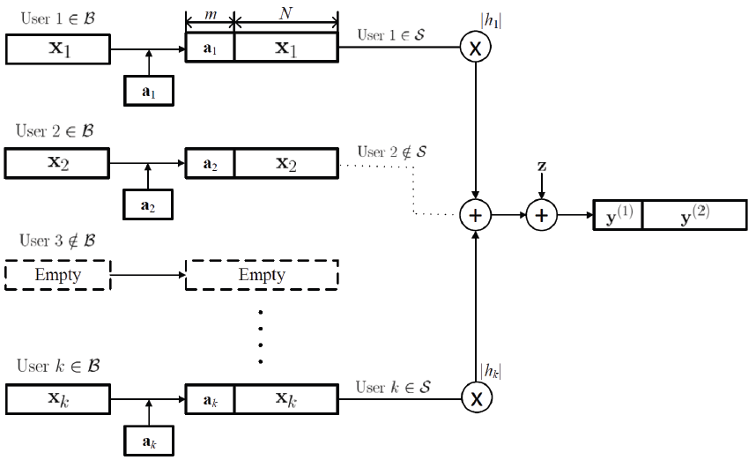
2-3
System model
β: probability that each user has a packet to transmit
α = m/k

Slide 12
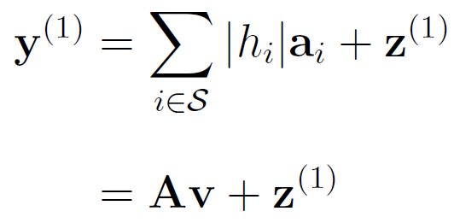
2-3
System Model
Received signal
If is small enough, active users could be identified by CS technique.
After successful identification, it is the same as multiple access channel.
Asymptotic system throughput
,where

Slide 13
2-4
Active User Identification
Conditions for successful identification (Lasso) [Wainwright2, 2009]
# of transmitting users:
Minimum effective channel gain:
Need for distributed scheduling
For the situation when β is quite large to use Lasso
s and v_{min} have to be controlled for successful identification.

Slide 14
2-5
Distributed Random Scheduling
Random access probability q
# of transmitting users follows binomial distribution ~ B(k, βq)
Access probability maximizing asymptotic sum throughput:
Maximum asymptotic throughput:
As k grows, throughput increases.
Access probability and throughput are not functions of β.

Slide 15
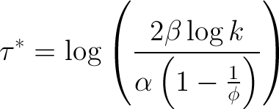
2-6
Thresholding based Distributed Scheduling
Importance of channel condition
For the higher rates
For the reliable user identification
Only the users who have channel gain |h_{i}|² >τ* transmit.
Threshold maximizing asymptotic throughput:
Maximum asymptotic throughput:
As k grows, throughput increases
Both threshold and throughput are functions of β.

Slide 16
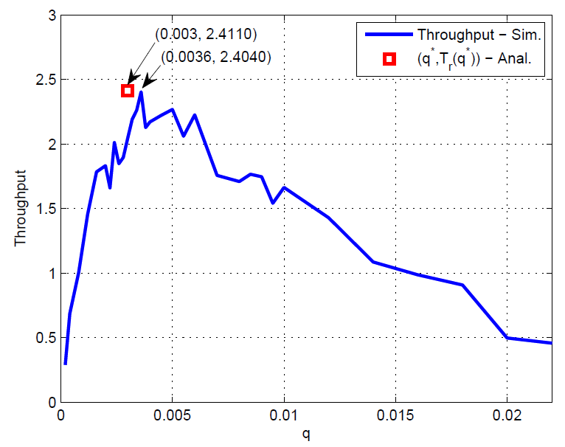
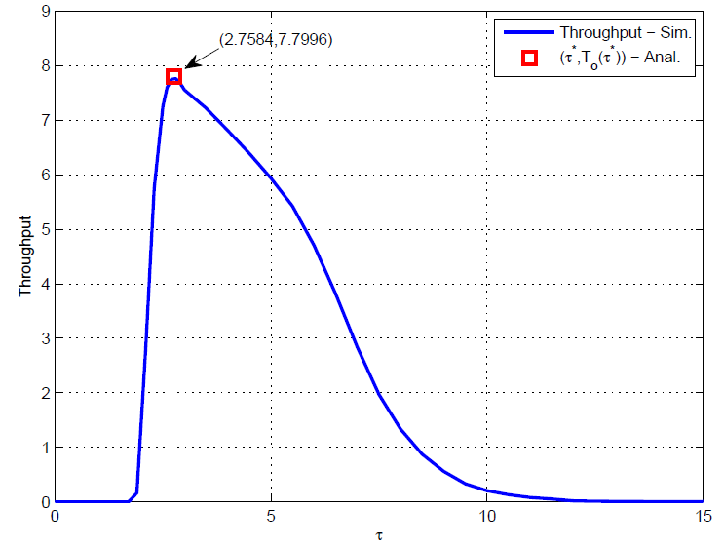
2-7
Simulation Results
k=2048, α=β=0.5
Distributed random scheduling
Thresholding based distributed scheduling
Random access probability
Threshold

Slide 17
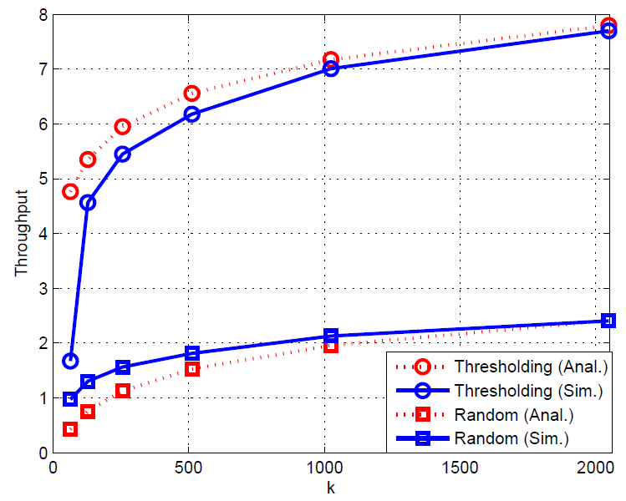
2-7
Simulation Results
α=β=0.5
Random scheduling with q* & Threshold scheduling with τ*
Total # of users

Slide 18
3rd
Support Set Recovery
with Unknown Sparsity Level

Slide 19
3-1
Support Set Recovery with Unknown Sparsity Level
Motivation
Literature has assumed that sparsity level s is known.
Hard to know exact value of s in advance
Unknown s would be a serious problem in support set recovery.
Support set recovery problem with unknown s may have different characteristics.
Ongoing work
Information theoretic limits on support set recovery with unknown s
Practical support set recovery methods with unknown s

Slide 20
Thank you

Slide 21
References
[Wu and Chen, 1998] W. Wu and K. Chen, “Identification of active users in synchronous CDMA multiuser detection,” IEEE J. Select. Areas Commun., vol. 16, no. 9, pp. 1723-1735, Dec. 1998.
[Lin and Lim, 2004] D. D. Lin and T. J. Lim, “subspace-based active user identification for a collision-free slotted ad hoc network,” IEEE Trans. Commun., vol. 52, no. 4, pp. 612-621, Apr. 2004.
[Jin, Kim, and Rao, 2011] Y. Jin, Y. H. Kim, B. D. Rao “Limits on support recovery of sparse signals via multiple-access communication techniques,” IEEE Trans. Inf. Theory, vol. 57, no. 12, pp. 7877-7892, Dec. 2011.
[Wainwright1, 2009] M. J. Wainwright, “Information-theoretic limits on sparsity recovery in the high-dimensional and noisy setting,” IEEE Trans. Inf. Theory, vol. 55, no. 12, pp. 5728-5741, Dec. 2009.
[Wainwright2, 2009] M. J. Wainwright, “Sharp thresholds for high-dimensional and noisy sparsity recovery using l1-constrained quadratic programming (Lasso),” vol. 55, no. 5, pp. 2183-2202, May 2009.

